Slide 1
Can blue-tilted primordial power spectrum save the small scale crisis in MW? From the perspective of Zoom-In simulation for MW host size dark matter halo
Jianhao WU
2nd year MPhil student @ Chinese U of HK, Prof. T. K. Chan’s AstroSim Group
--> Join Wisconsin-Madison as a PhD student in 2025 Fall
Personal website: https://rushingfox.github.io/
CosPA 2025, IBS Korea, 2025 July
Based on Paper: Cosmological Zoom-In Simulations of Milky Way Host Mass Dark Matter Halos with a Blue-Tilted Primordial Power Spectrum
Phys. Rev. D 112 (2025) 023512 [arXiv:2412.16072]
Jianhao Wu(CUHK), Tsang Keung Chan(CUHK), Victor J. Forouhar Moreno(Leiden).

Slide 2
1. Background and Motivations

Slide 3
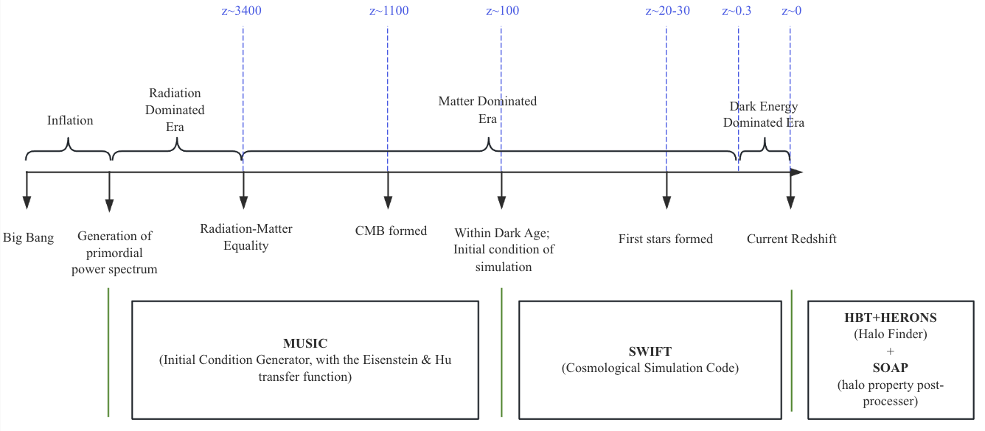
Standard Cosmology Model
The standard cosmology model consists of:
The single-field slow-roll inflationary model, which would generate a power law primordial power spectrum at very early universe
The LCDM model, which dominates the later evolution of the universe
[Wu, TKC & Moreno PRD 2025]

Slide 4
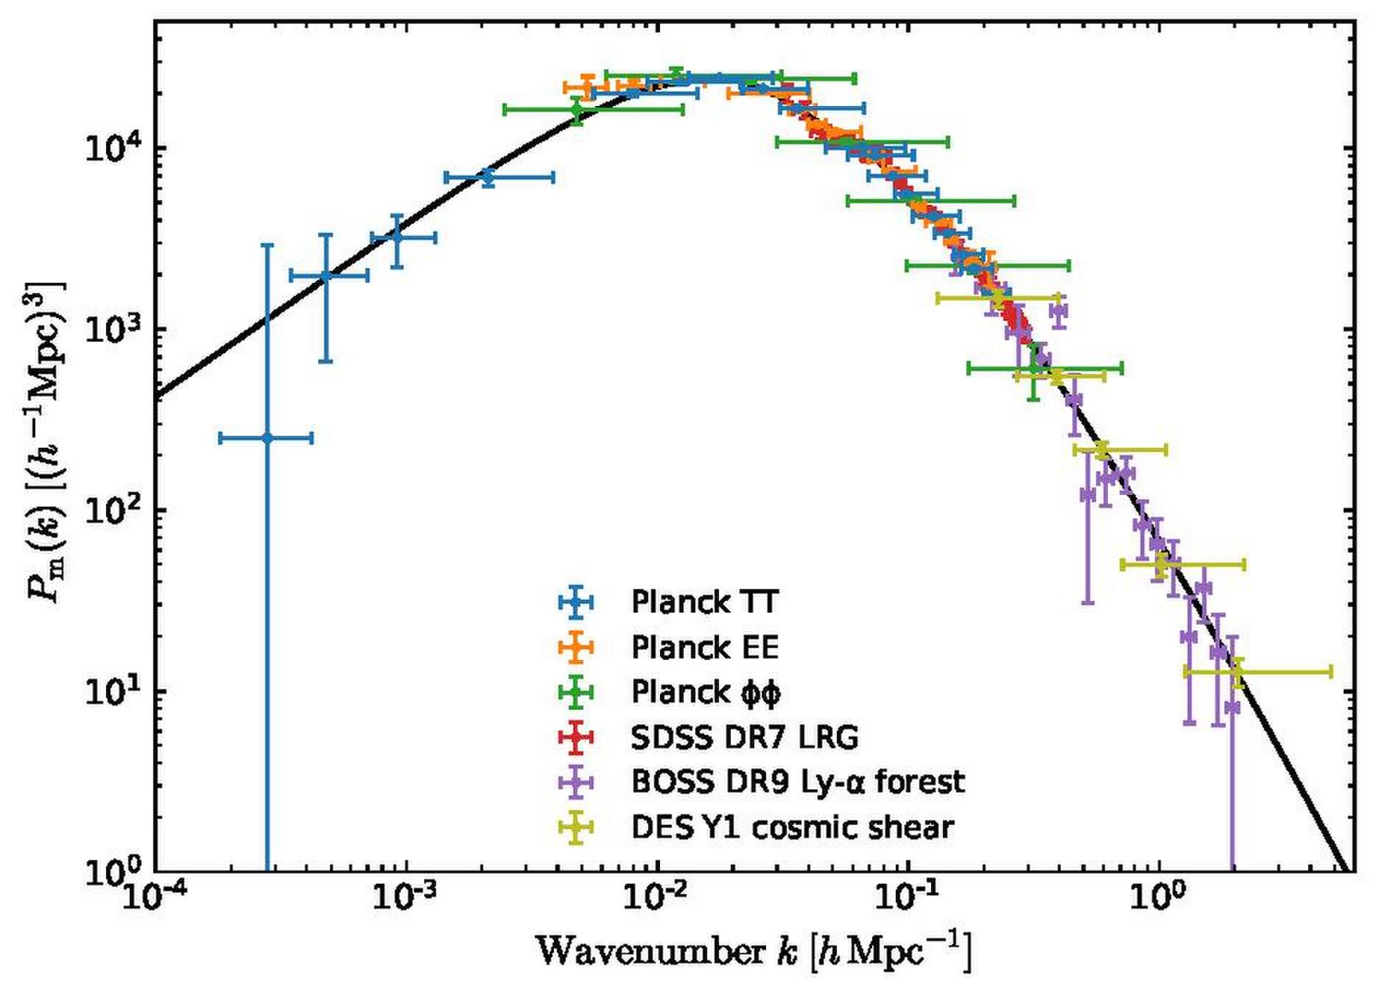
Uncertain at small scales
Standard cosmology model has achieved
great success during the past several
decades, on large scale of universe
However on small scales the primordial power
spectrum is loosely constrained
MW host dark matter halo’s size corresponds to ~2.5 h/Mpc

Slide 5
A small-scale enhanced or suppressed?
There is already a paper using a small scale enhanced primordial power spectrum to explain the early formed massive galaxies in JWST
Besides, several other observations are in favor of a small scale enhanced cosmological model—we are trying to address them!
Even CDM model could not solve the “anomalous” flux ratio problem in strong lensing: a larger fraction mass of substructure is required (arxiv [0903.4559])+ over-concentrated subhalo event is detected (SDSSJ0946+1006, i.e. “Jack Pot” lensing event)
A too-many-satellite-galaxies problem appeared in nearby galaxy observation (arxiv [1711.06267] [2403.08717])

Slide 6
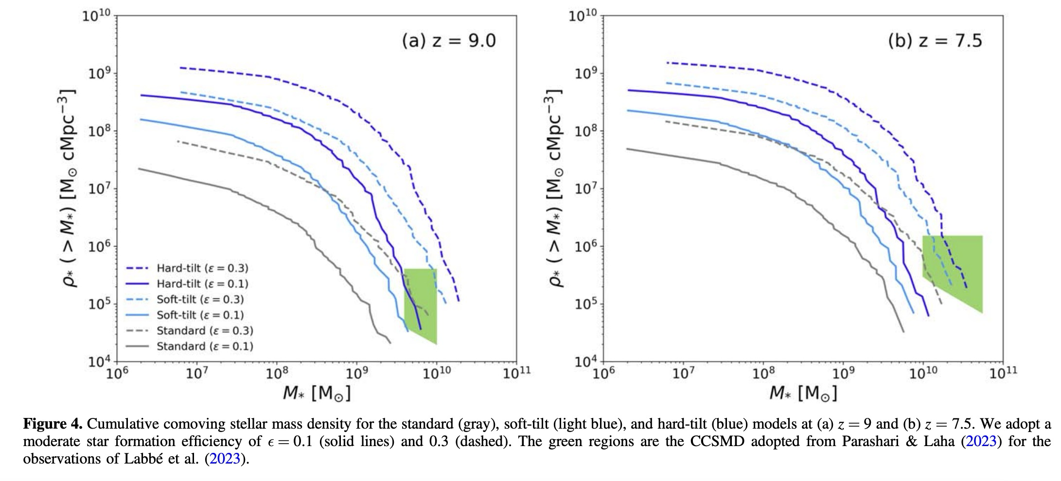
A small scale enhanced primordial power spectrum could explain JWST early structure formation!
[Shingo Hirano, Naoki Yoshida 2023]
Green region is from JWST
Could have more moderate star formation rate than standard cosmology model!

Slide 7
“anomalous” flux ratio problem
[D. D. Xu , Shude Mao et al 2009]
From strong lensing
The flux ratio anomalies in strong lensing was expected to be solved by high-resolution simulations for CDM halos, as the substructure would appear if the resolution is high enough
But it failed
From LCDM N-body high resolution simulation

Slide 8
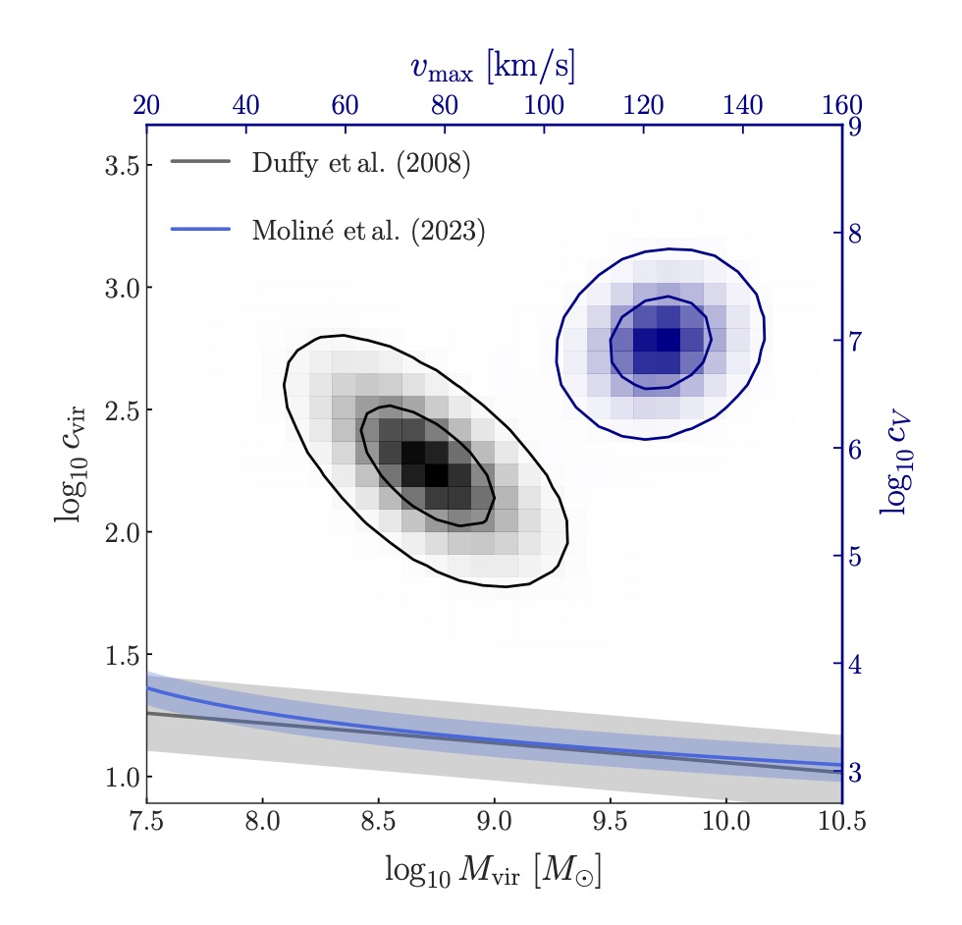
over-concentration event
There are several reports for over-concentrated halos/subhalos in strong lensing:
J0946+1006: a subhalo with 12 sigma deviation from subhalo C-M relation
B1938+666: a field halo with 4 sigma deviation from field halo C-M relation
[M. Tajalli, S. Vegetti, et al arxiv 2025]

Slide 9
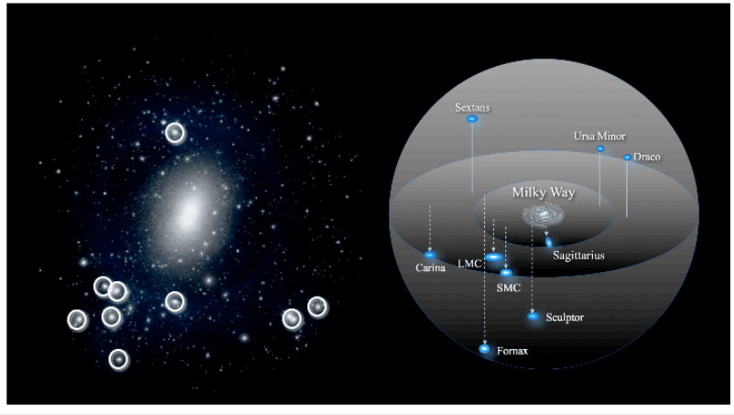
MW satellite galaxies can help constrain small scale！
A satellite galaxy is a smaller galaxy that orbits around a larger galaxy due to gravitational forces
Milky-Way has ≳50 satellite galaxies!

Slide 10
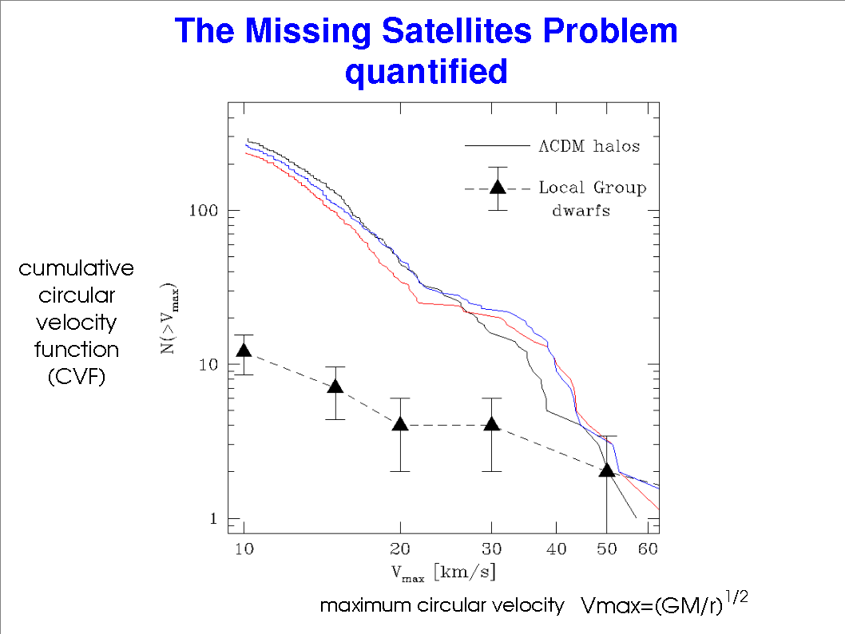
The old Missing Satellite Problem in standard cosmology model
MSP:
observation < theoretical (simulation) prediction
source: astro-ph/0401088

Slide 11
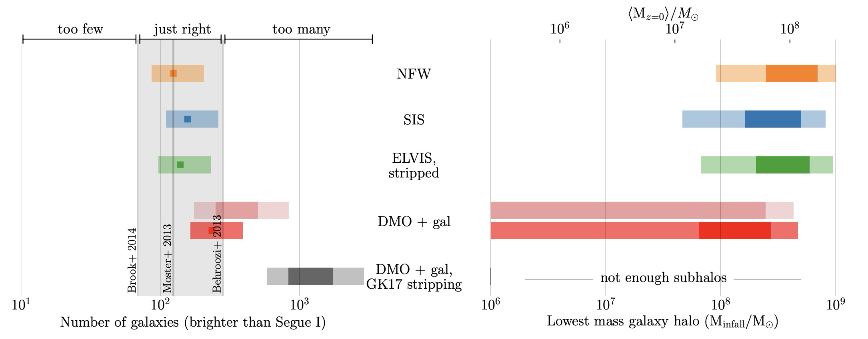
Observation is underestimated! Then Missing Satellite Problem->Too Many Satellites problem!
Reionization could prevent star formation
Completeness Check: fainter satellite galaxy could only be observed within a much smaller radius/volume
When considering the tidal stripping by central baryonic disk of MW, the satellites would be too many!
source: arxiv [1711.06267]

Slide 12
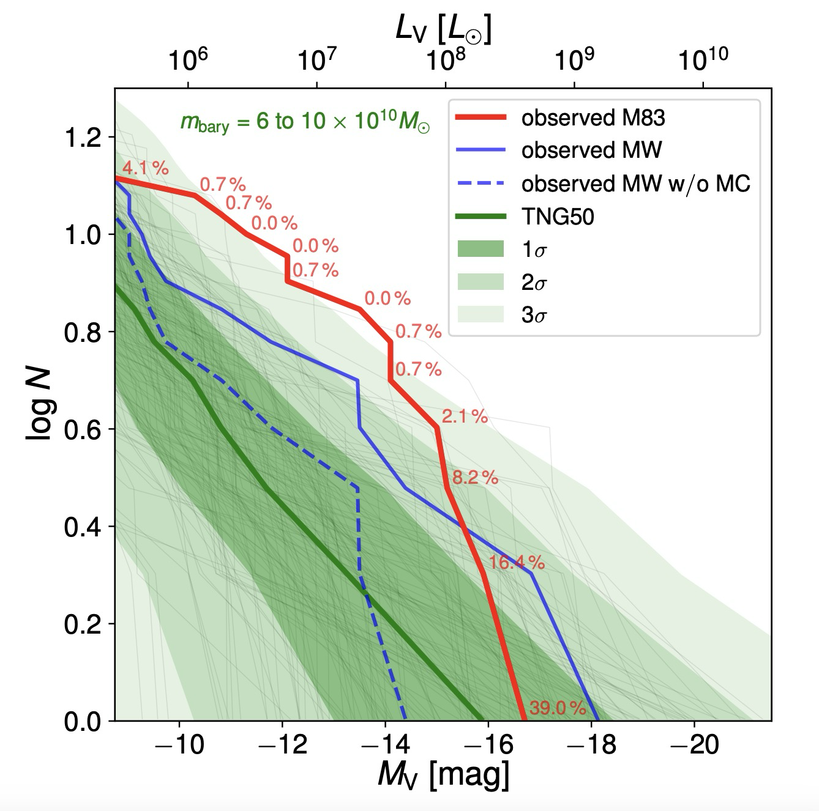
There are also direct observations for more satellite galaxies in nearby MW size galaxies!
M83 host dark matter halo is at the similar mass as MW’s!
Number of subhalos with luminosity higher than L
source: arxiv [2403.08717]

Slide 13
2. To solve the Too-Many-Satellites Problem

Slide 14
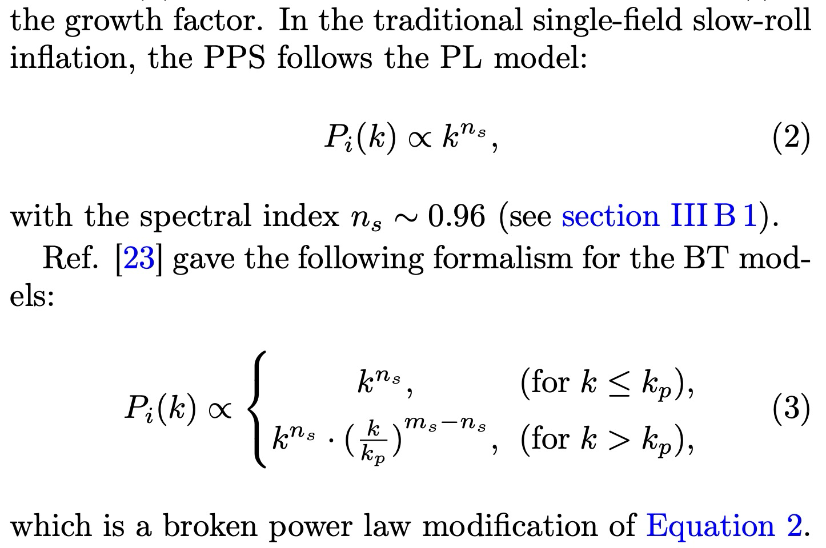
Change Power Law Primordial Power Spectrum->Broken Power Law!
Larger spectral index at small scale end (large k), to give small scale enhancement!
old model
blue-tilted model
[Wu, TKC & Moreno arxiv 2024]

Slide 15
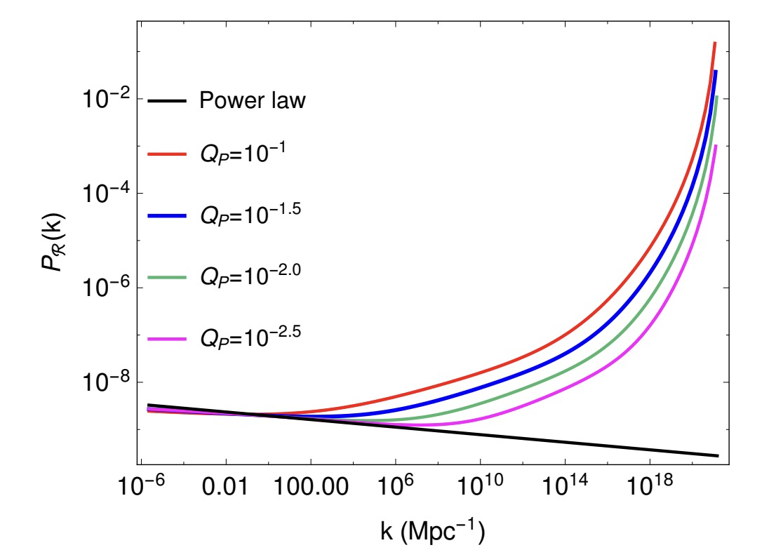
There are already some inflationary scenarios producing small scale enhancement!
Warm Inflation：
There is a thermal bath which the scalar
field could interact with
The power spectrum would have small
scale enhancement!
(Arya et al, JCAP02 (2018) 043)
(Berera et al. (2009)).

Slide 16
How to choose parameter sets? Besides JWST, its hosting satellite galaxy’s central density (concentration) could also constrain Primordial Power!
They assume:
“the main effect of the change is on the halo concentration, while galaxy evolution is assumed to be unaffected.”
source: arxiv [2407.04198]

Slide 17
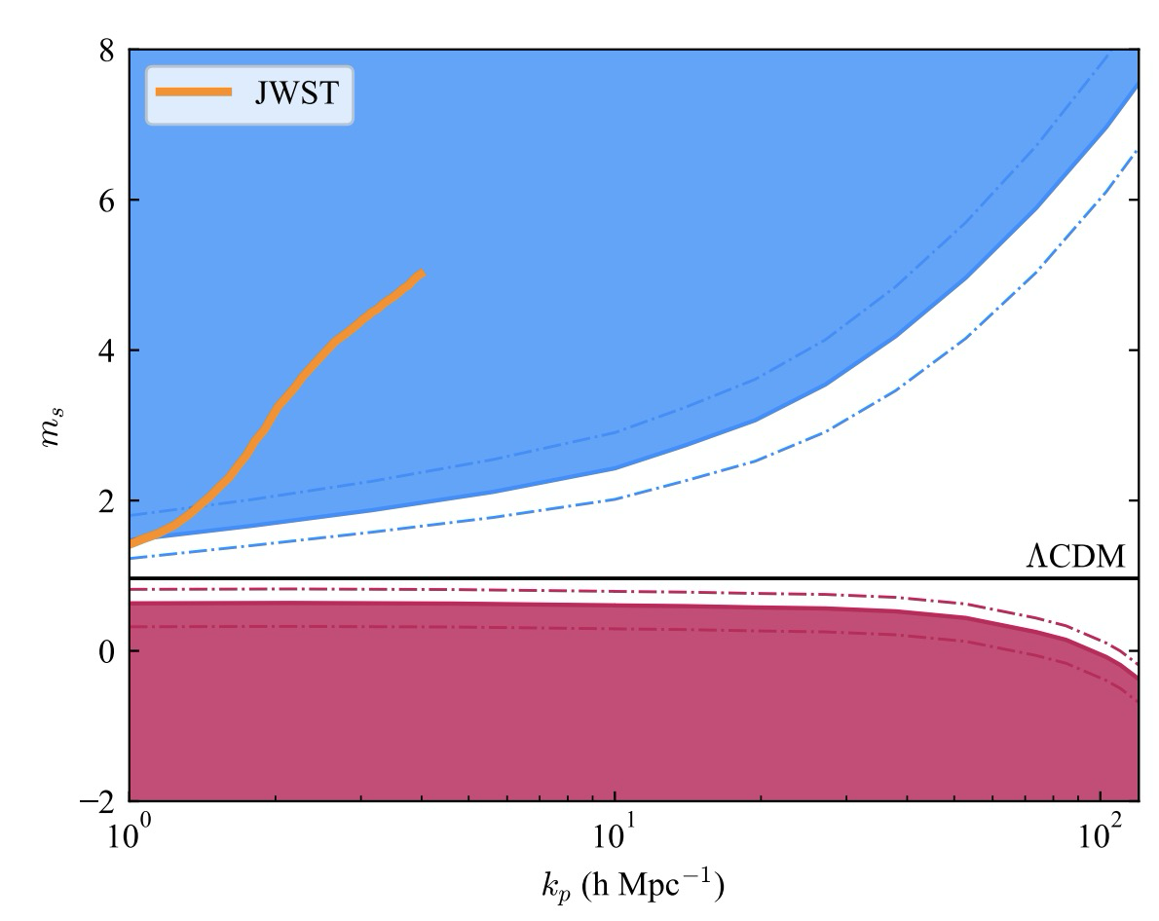
We chose two blue-tilted parameter sets within the allowable parameter space!
One could ease the tension of high star formation rate brought by JWST, while another could not
Both are within (or at least on the border of parameter space :) )
source: arxiv [2407.04198]
Two BT models we chose!

Slide 18
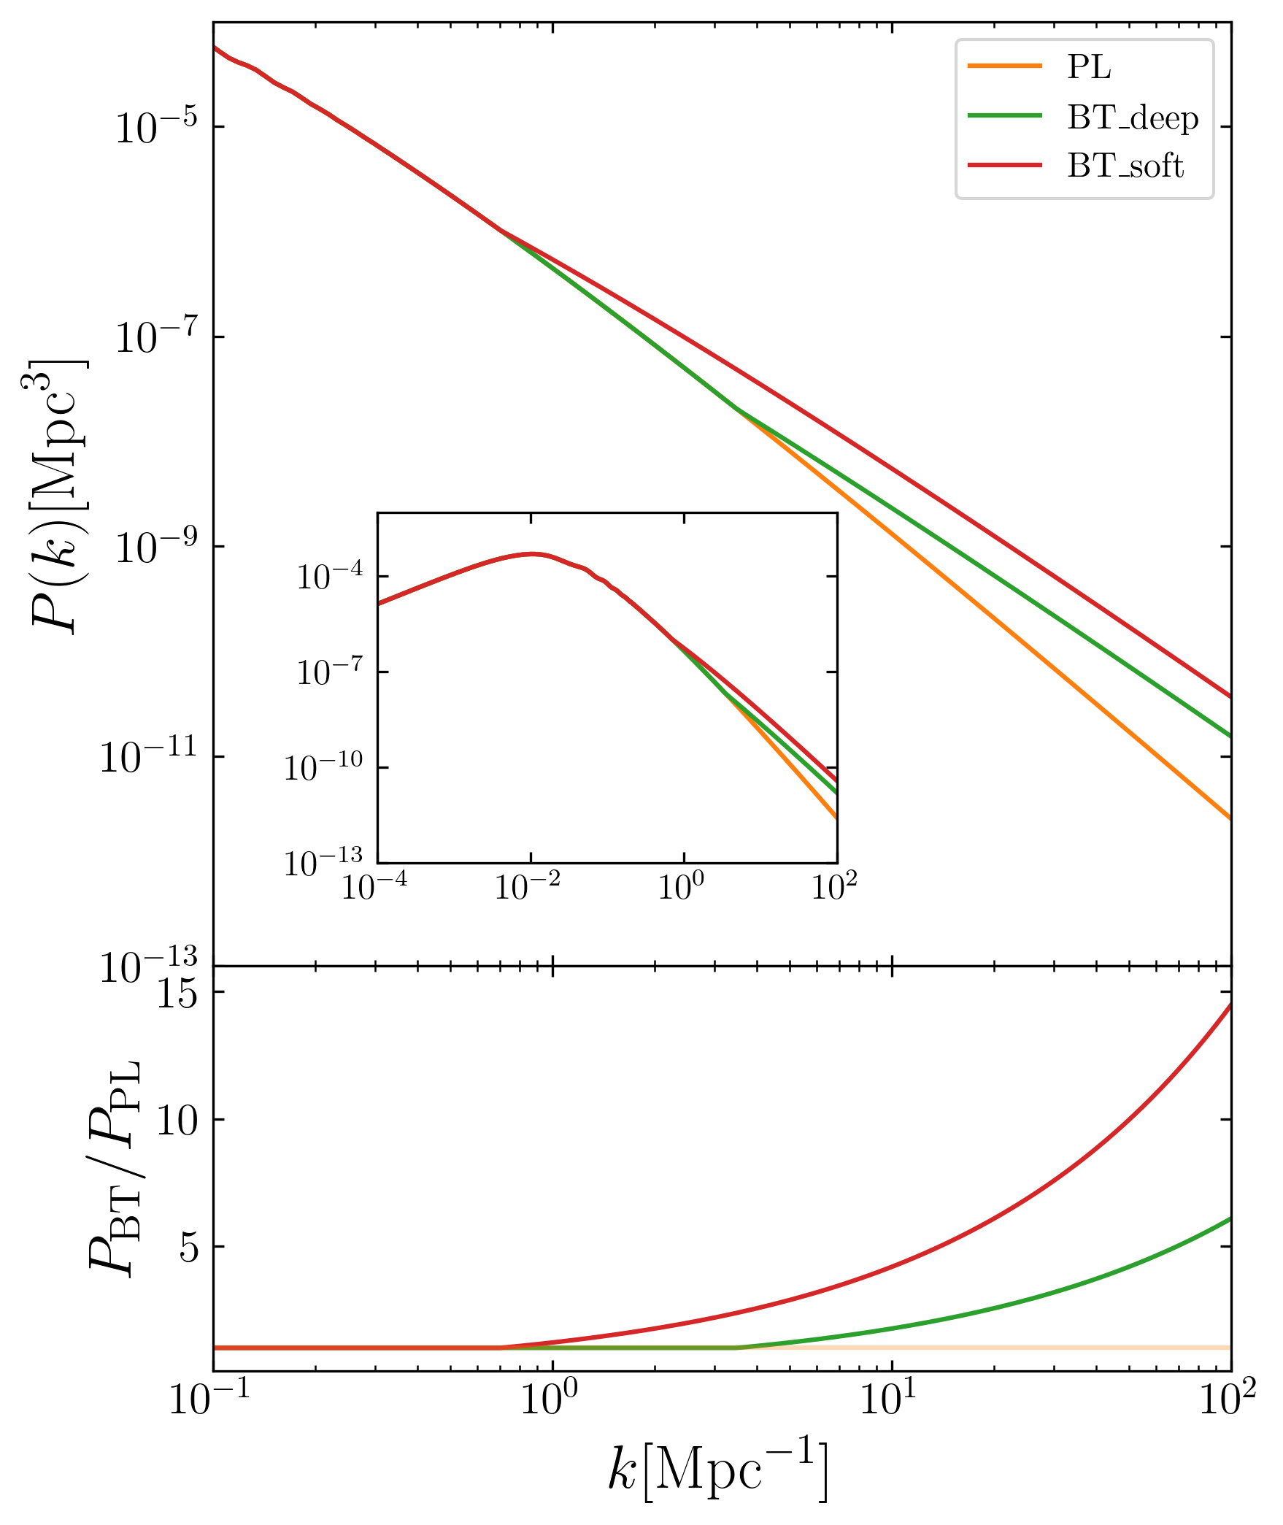
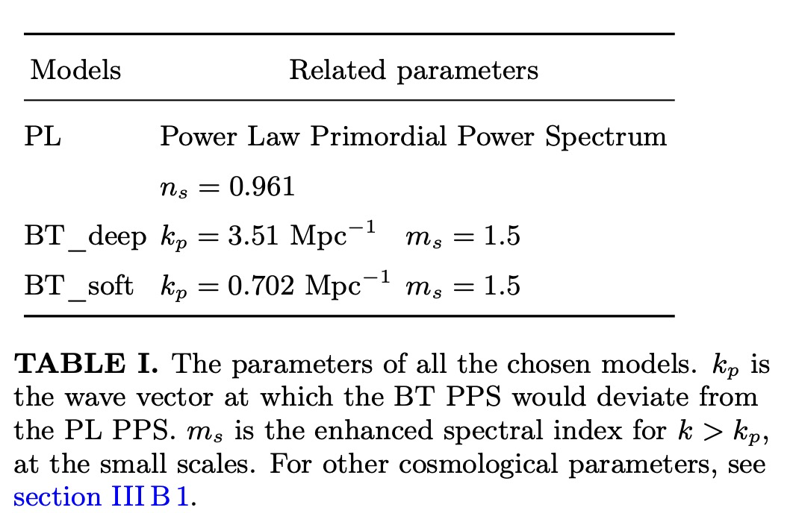
Two blue-tilted models
We chose two sets of parameters for blue-tilted
model (BT model), along with the standard model
(power-law model aka PL model here)
[Wu, TKC & Moreno arxiv 2024]

Slide 19
Broken point’s scale corresponds to a cosmic structure mass scale
$k_{p}$ should correspond to a mass scale for cosmic structure, only below which blue-tilted model could affect.
How to get it?
wave number $k_{p}$ ->
wave length λ->
A sphere whose radius $r_{l}=\frac{1}{2}$λ
For BT_deep: $1.1×{10}^{11}M_{⨀}$
For BT_soft: $1.4×{10}^{13}M_{⨀}$
Both could cover the mass scale for most dark matter subhalos in MW host (${10}^{12}M_{⨀}$)!

Slide 20
Numerical pipeline we used
After changing the primordial power spectrum, then use cosmological simulation to evolve to current redshift!
[Wu, TKC & Moreno arxiv 2024]
Upper panel: universe history
Bottom panel: numerical codes

Slide 21
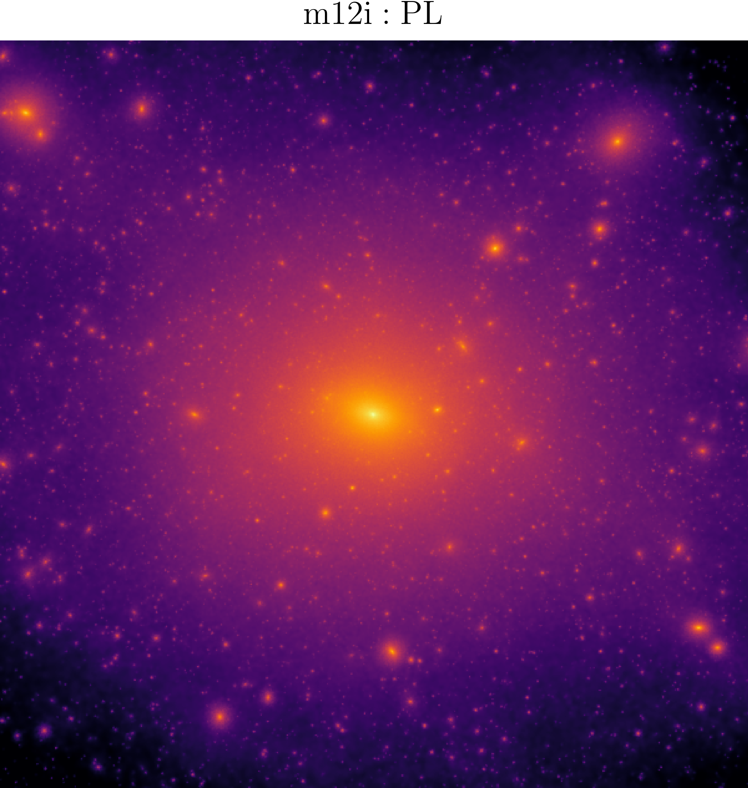
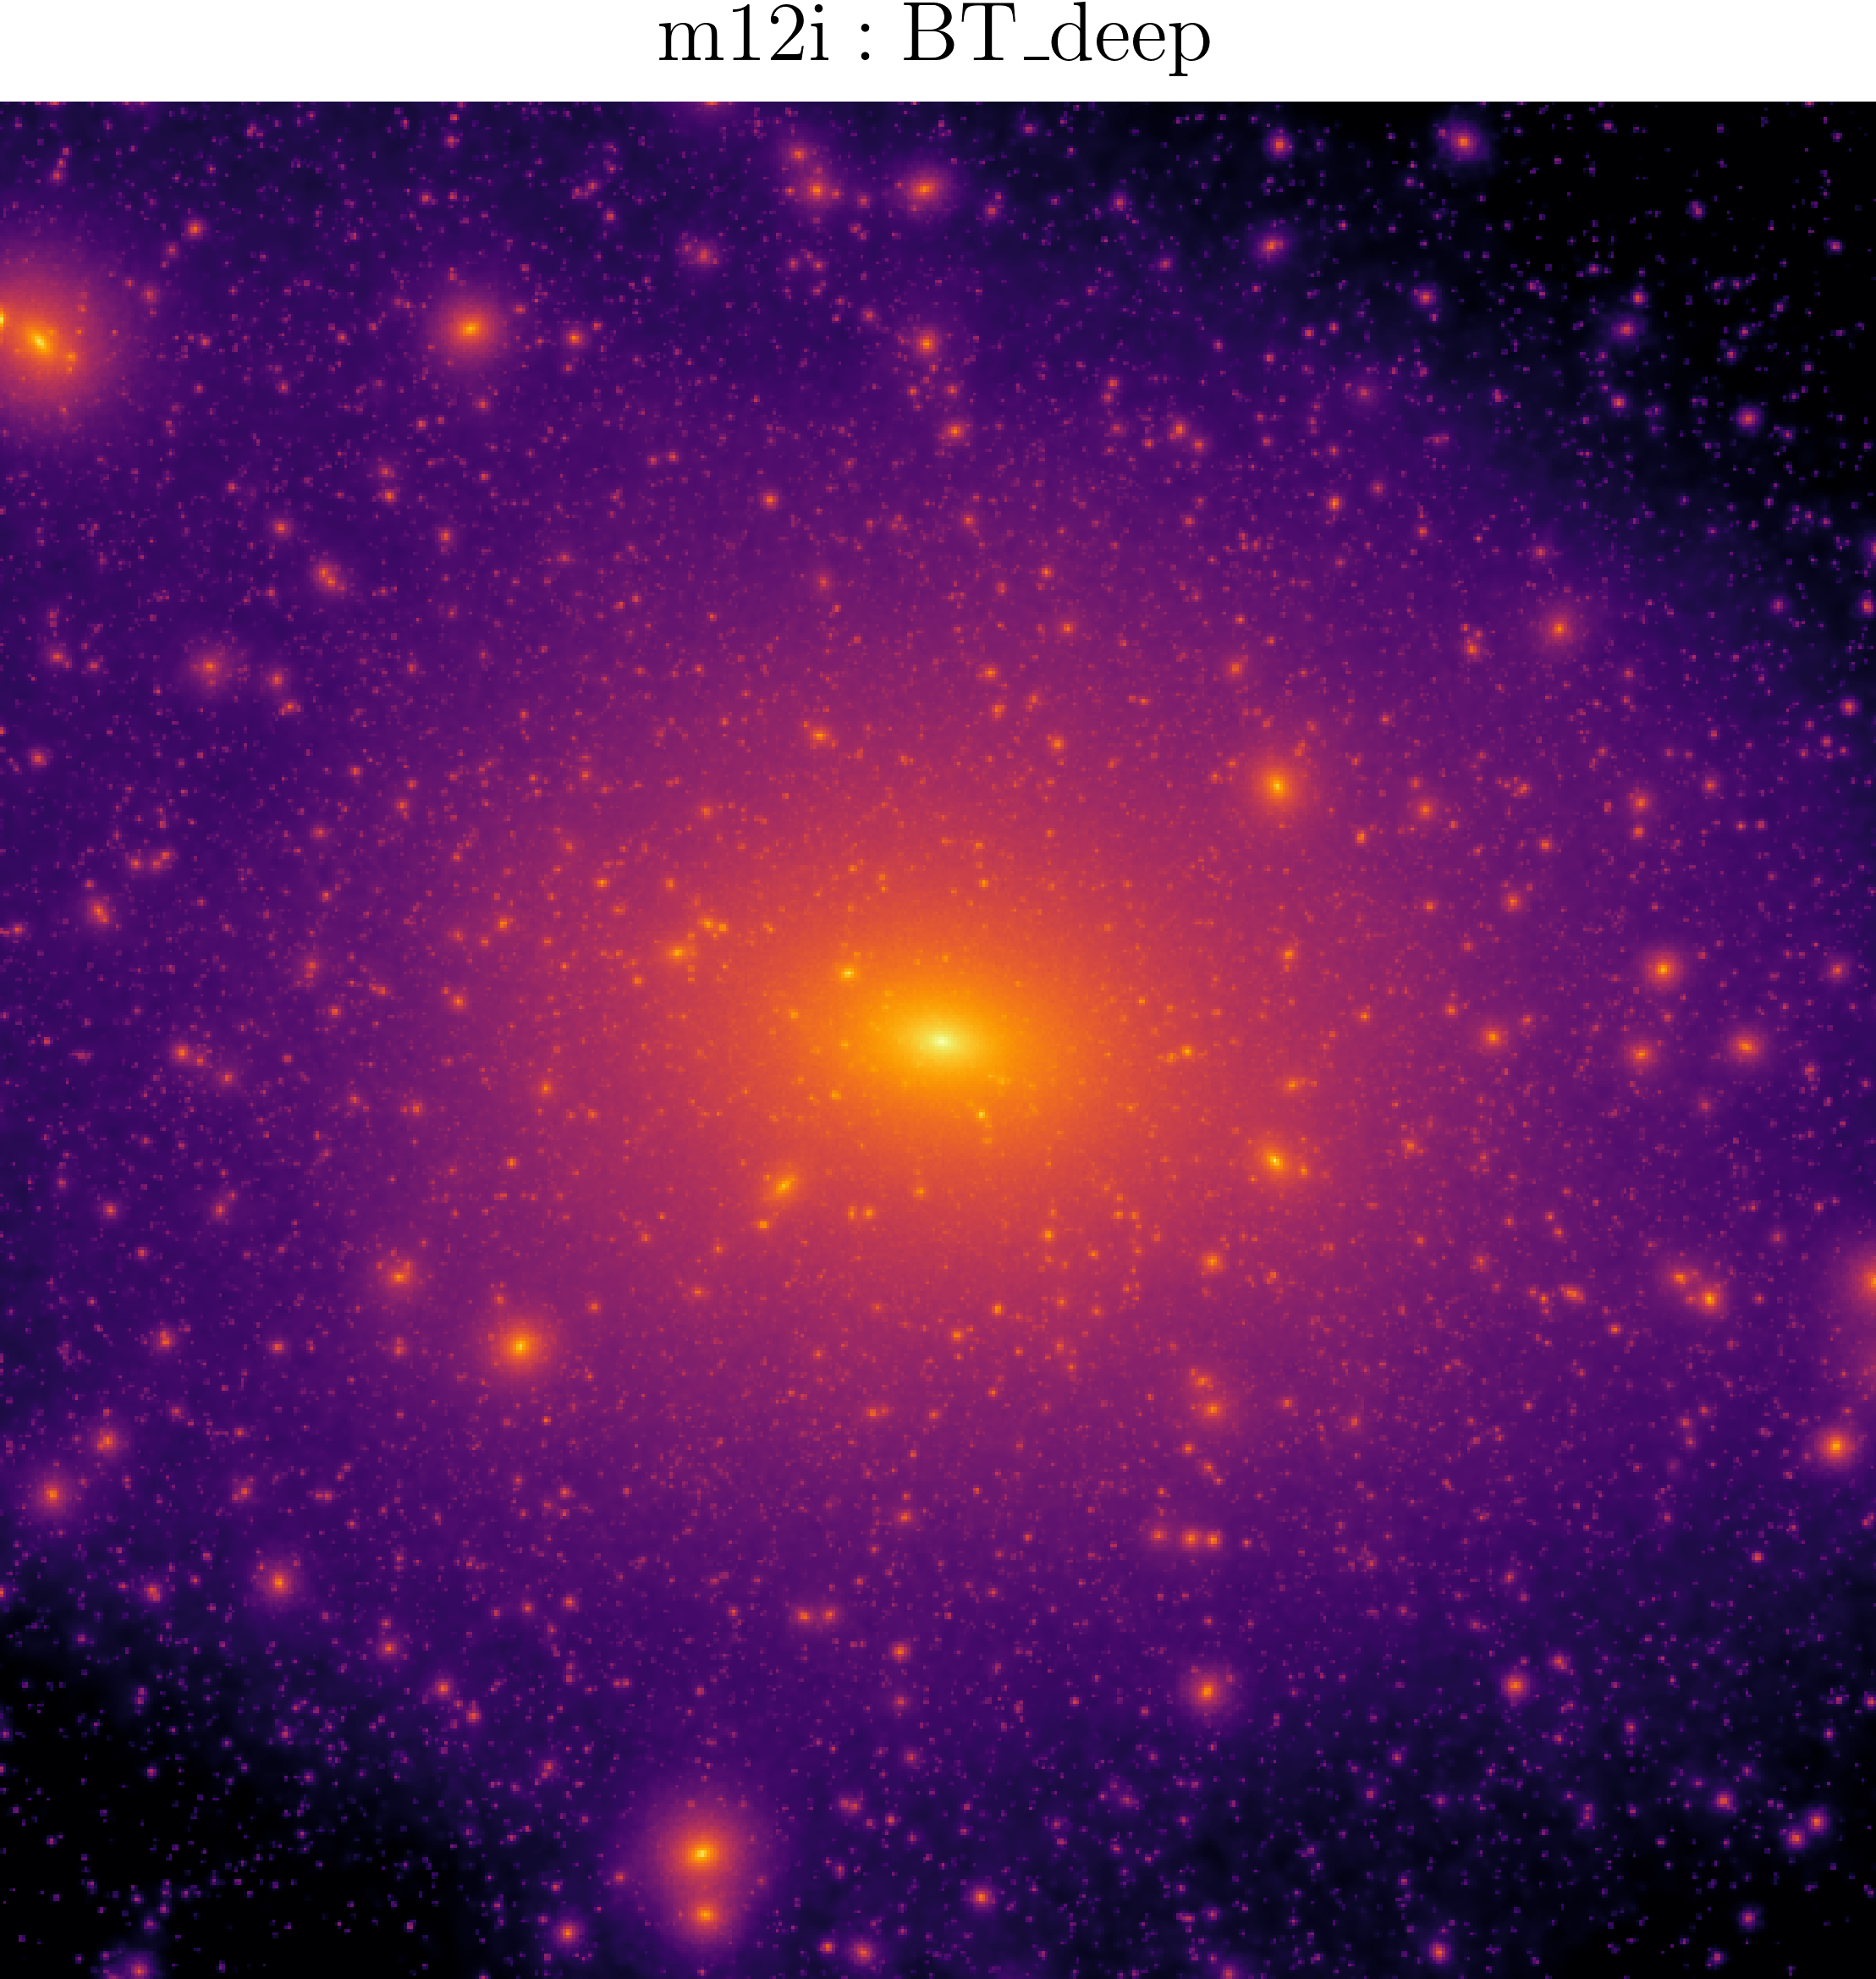
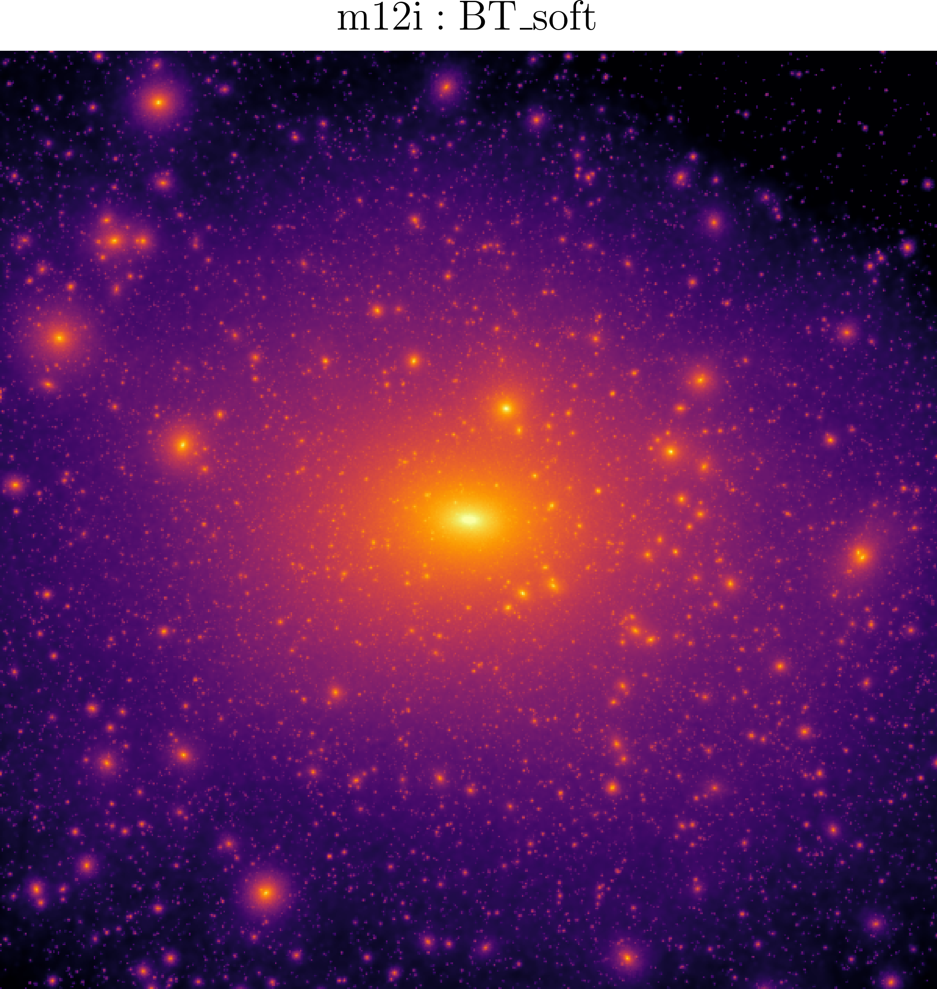
Intuitive look: projection map
dark matter 2D projection map, with side length 400 kpc
[Wu, TKC & Moreno arxiv 2024]
Both BT models give more subhalos than power-law!

Slide 22
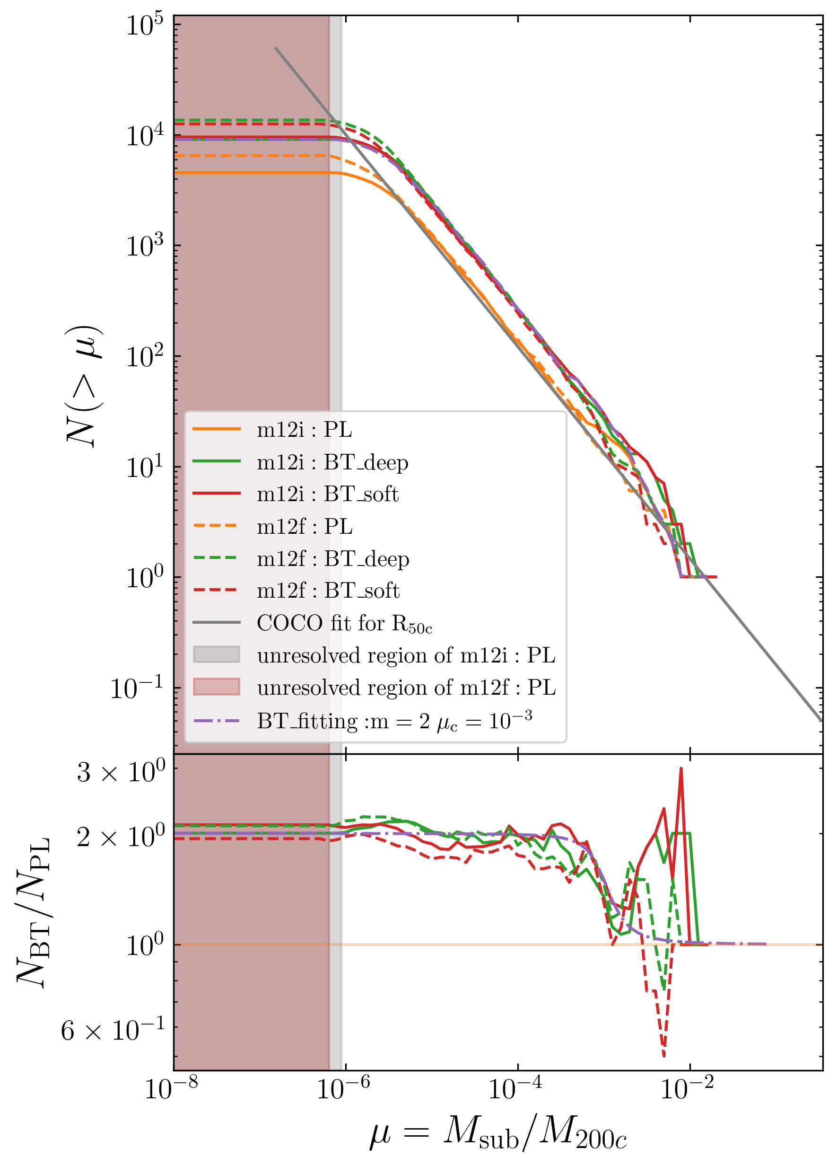
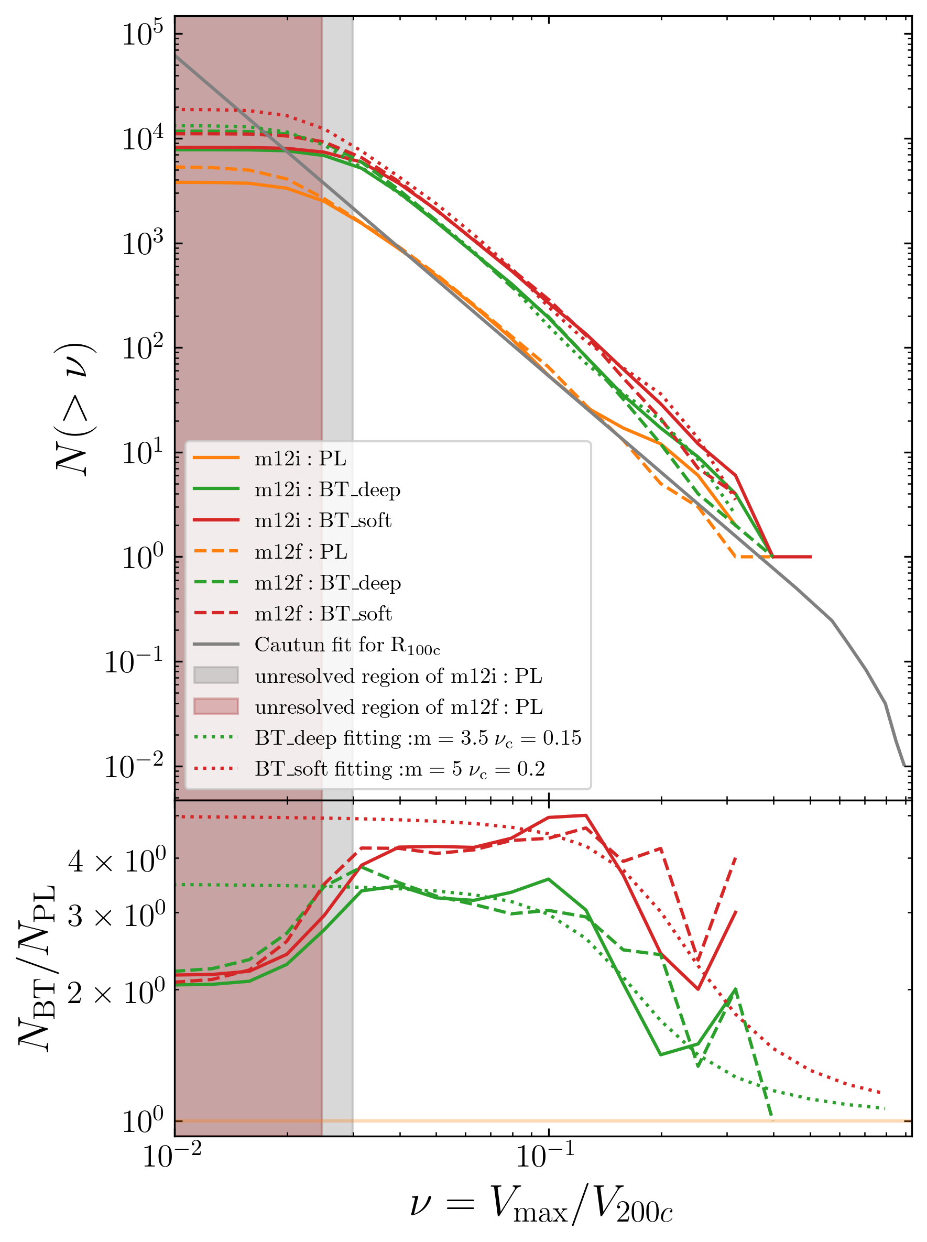
To help the Too-Many-Satellites (Mass/Vmax)
subhalo function(aka subhalo number distribution) by mass or Vmax
subhalo mass function could
be enhanced by a factor of two
at low mass end
subhalo Vmax function could
be enhanced by more than 3
times at low Vmax end
scaled mass
scaled Vmax
[Wu, TKC & Moreno arxiv 2024]
Number of subhalos
Ratios between numbers
The ratio for both functions, observes an inverse S shape function!

Slide 23
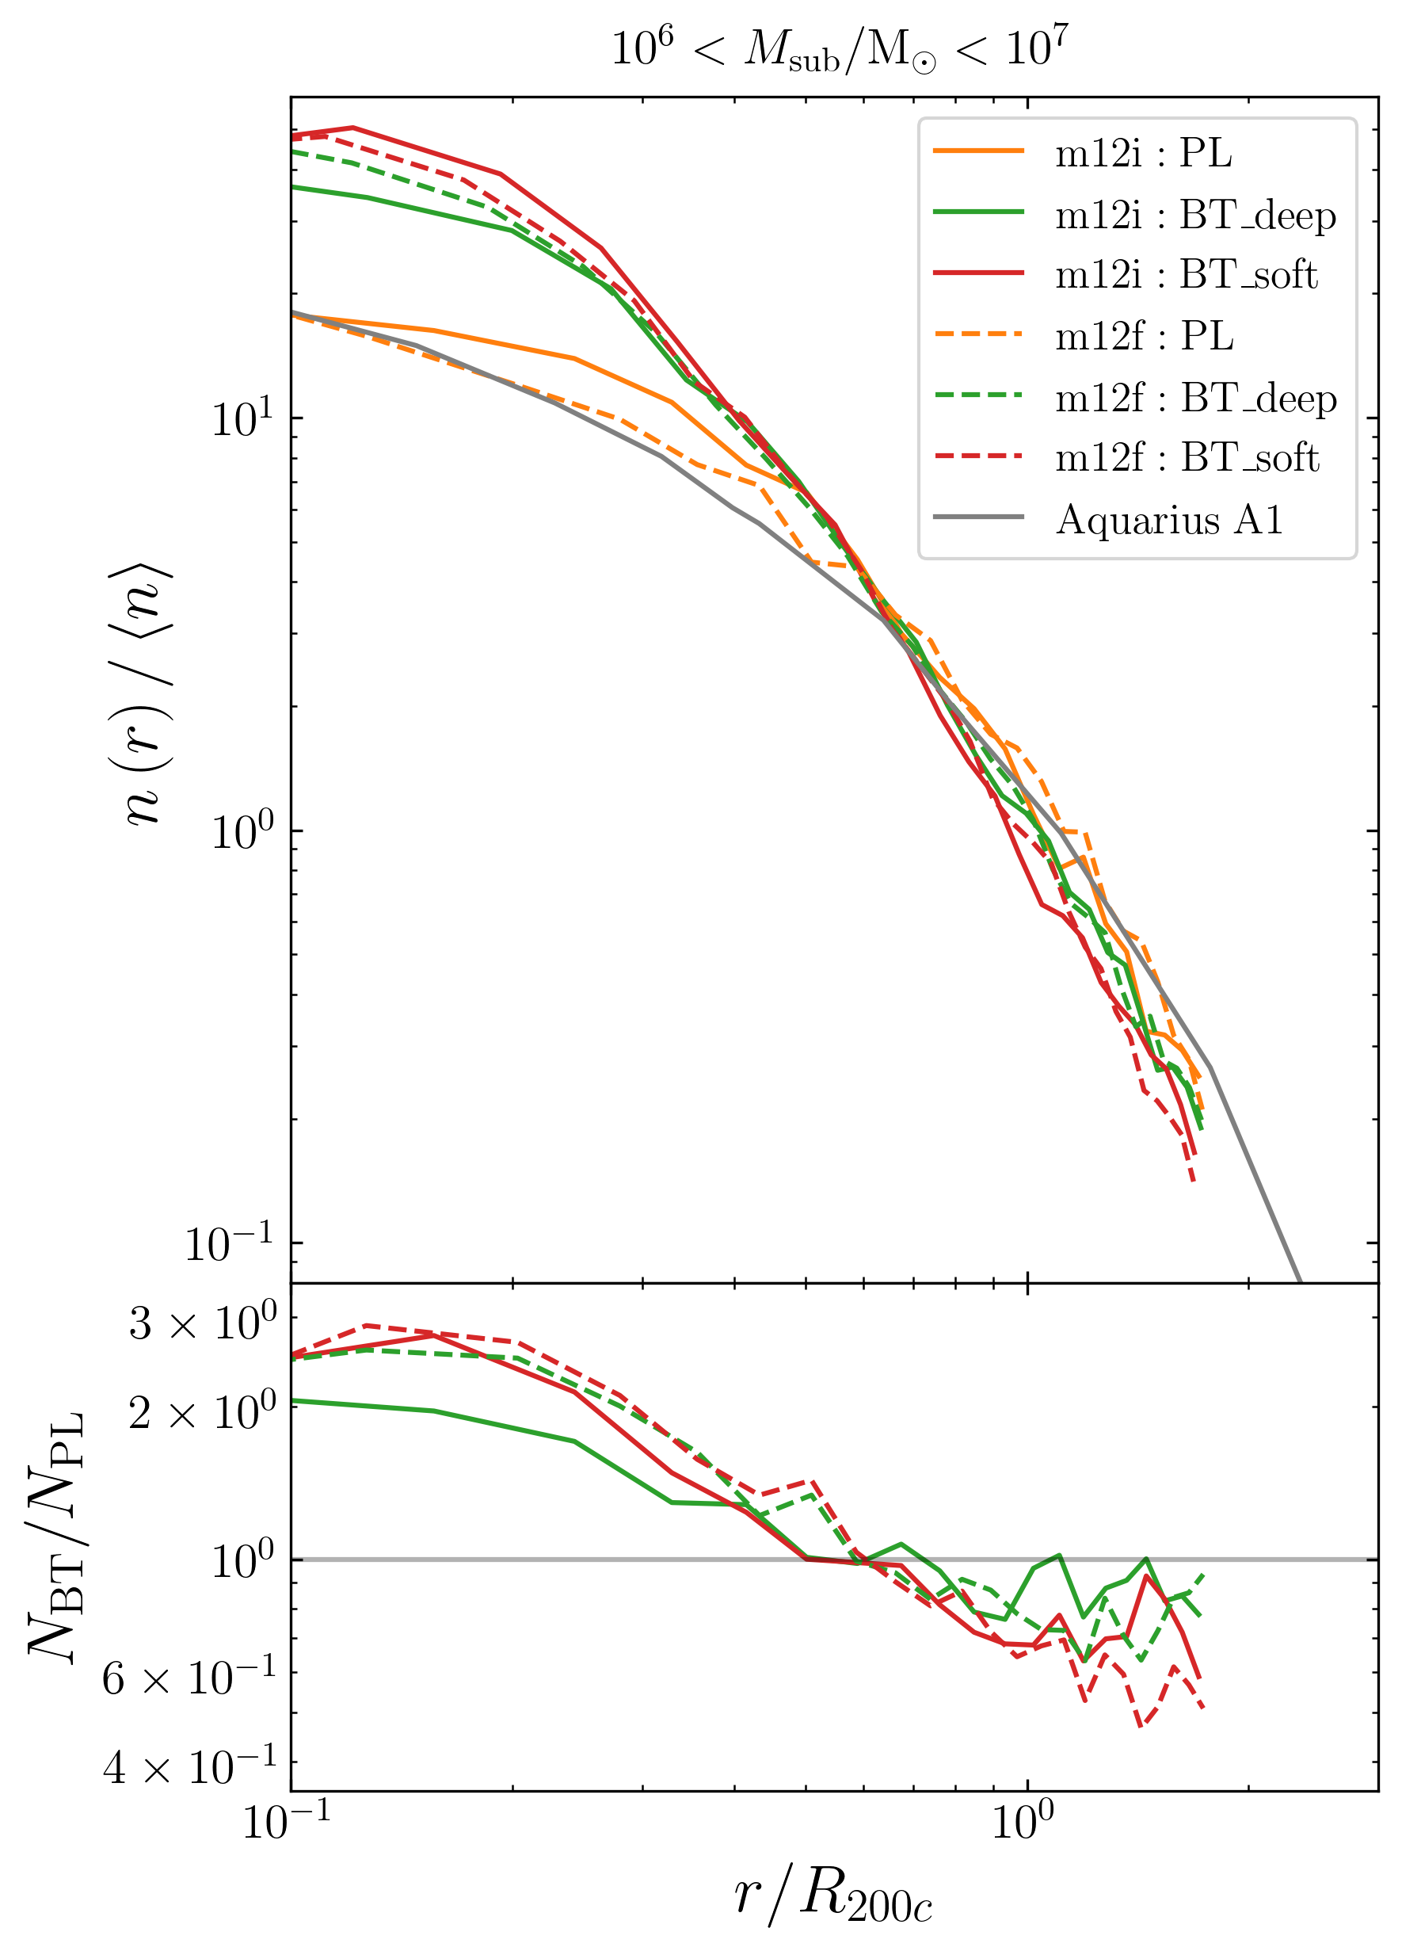
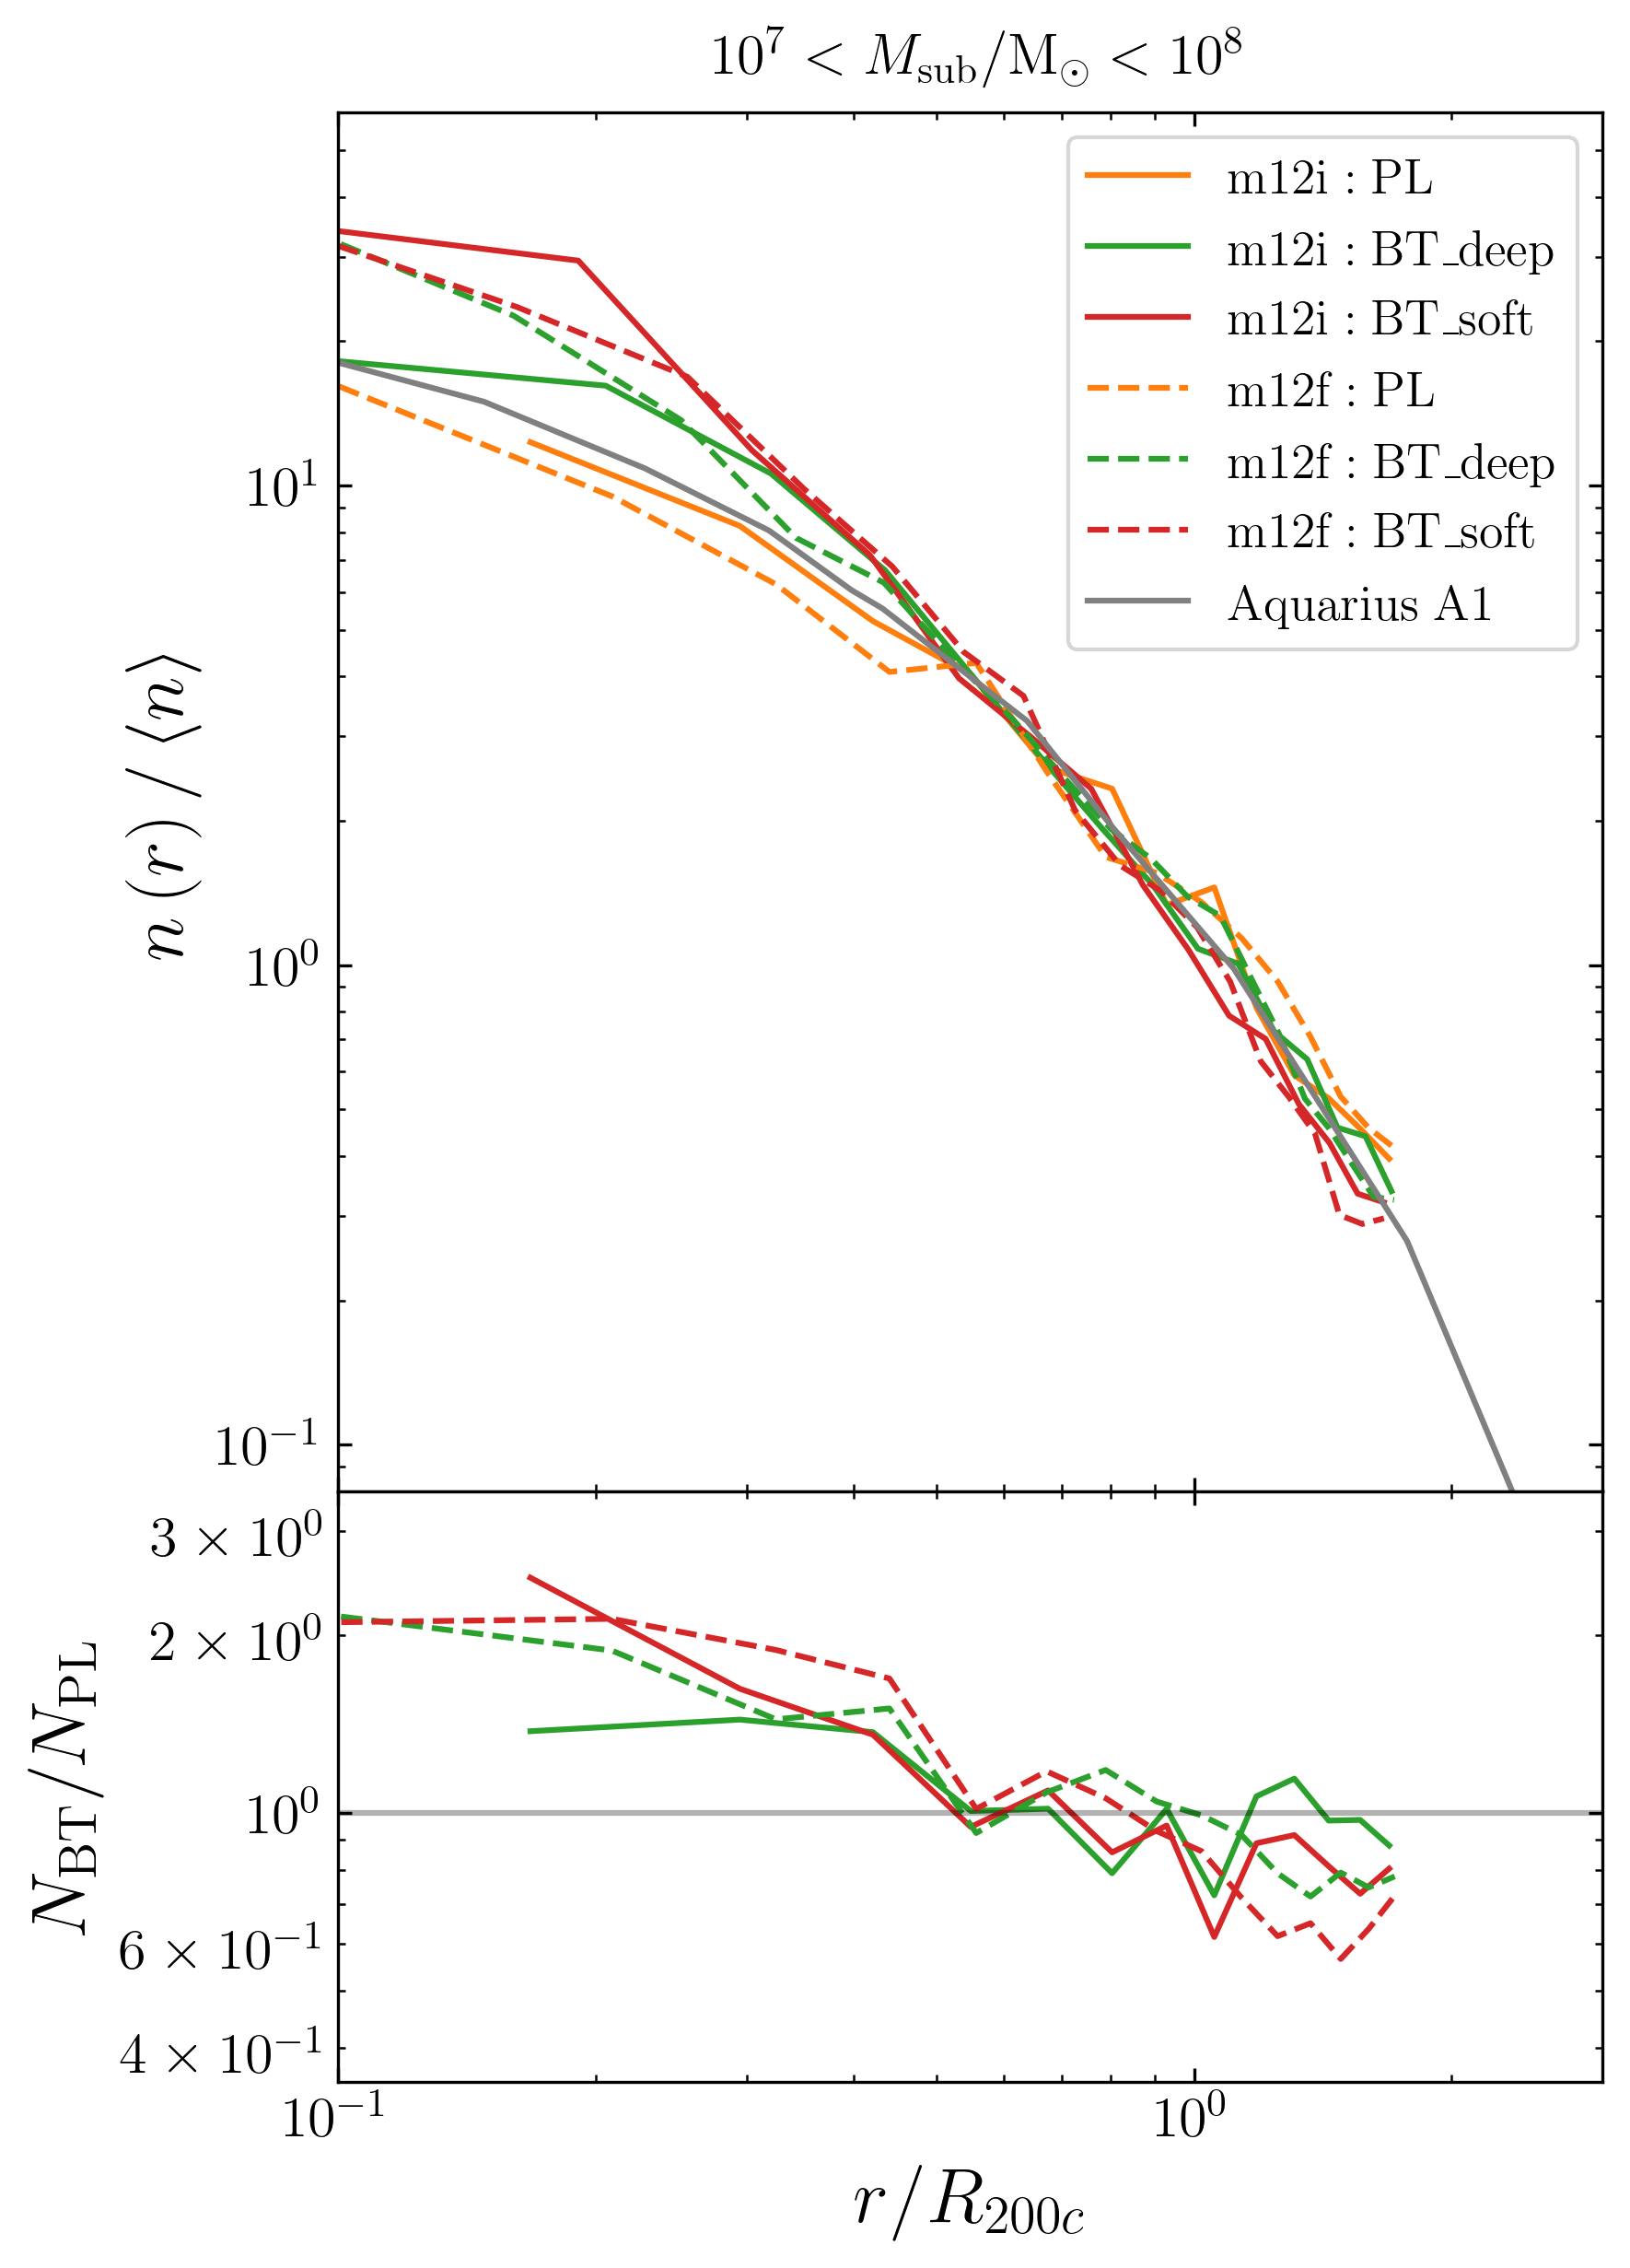
To help the Too-Many-Satellites (radial distance)
radial distance from the center of main halo
At inner region of main halo,
normalized number density nearly
doubled
[Wu, TKC & Moreno arxiv 2024]
scaled radial distance
scaled radial distance
Normalized number density
Grey lines are the same for different mass!
(Found by Aquarius simulation [arxiv0809.0898])
Ratio(BT over PL)

Slide 24
To help the Too-Many-Satellites (BD potential simulation)
Recall: the too-many-satellites problem is originated from considering baryonic disk potential → Click
We followed [GK et al 2017] to carry out the simulations with central baryonic disk potential!
However, for external potential SWIFT only supports potential center to be fixed. So I modified SWIFT code to permit the center moving!
Run fof at each time step instead of only running fof at each snapshot
Adjust the disk center to be the fof center for the main halo in each time step

Slide 25
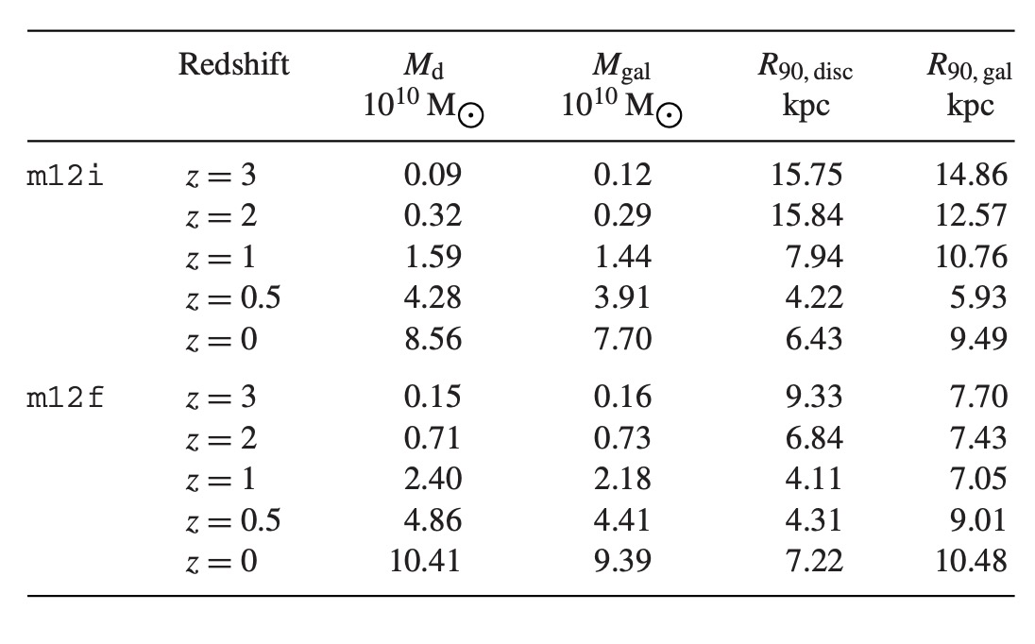
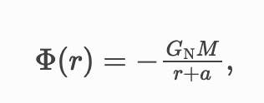
To help the Too-Many-Satellites (BD potential simulation)
[GK et al 2017]
Set up the baryonic disk potential:
[GK et al 2017] calculated the potential parameters by reading the FIRE hydro simulation catalogues
[GK et al 2017] also shows Hernquist form potential behaves similar as MN form potential, while the former has fewer parameters, so we chose Hernquist form!

Slide 26
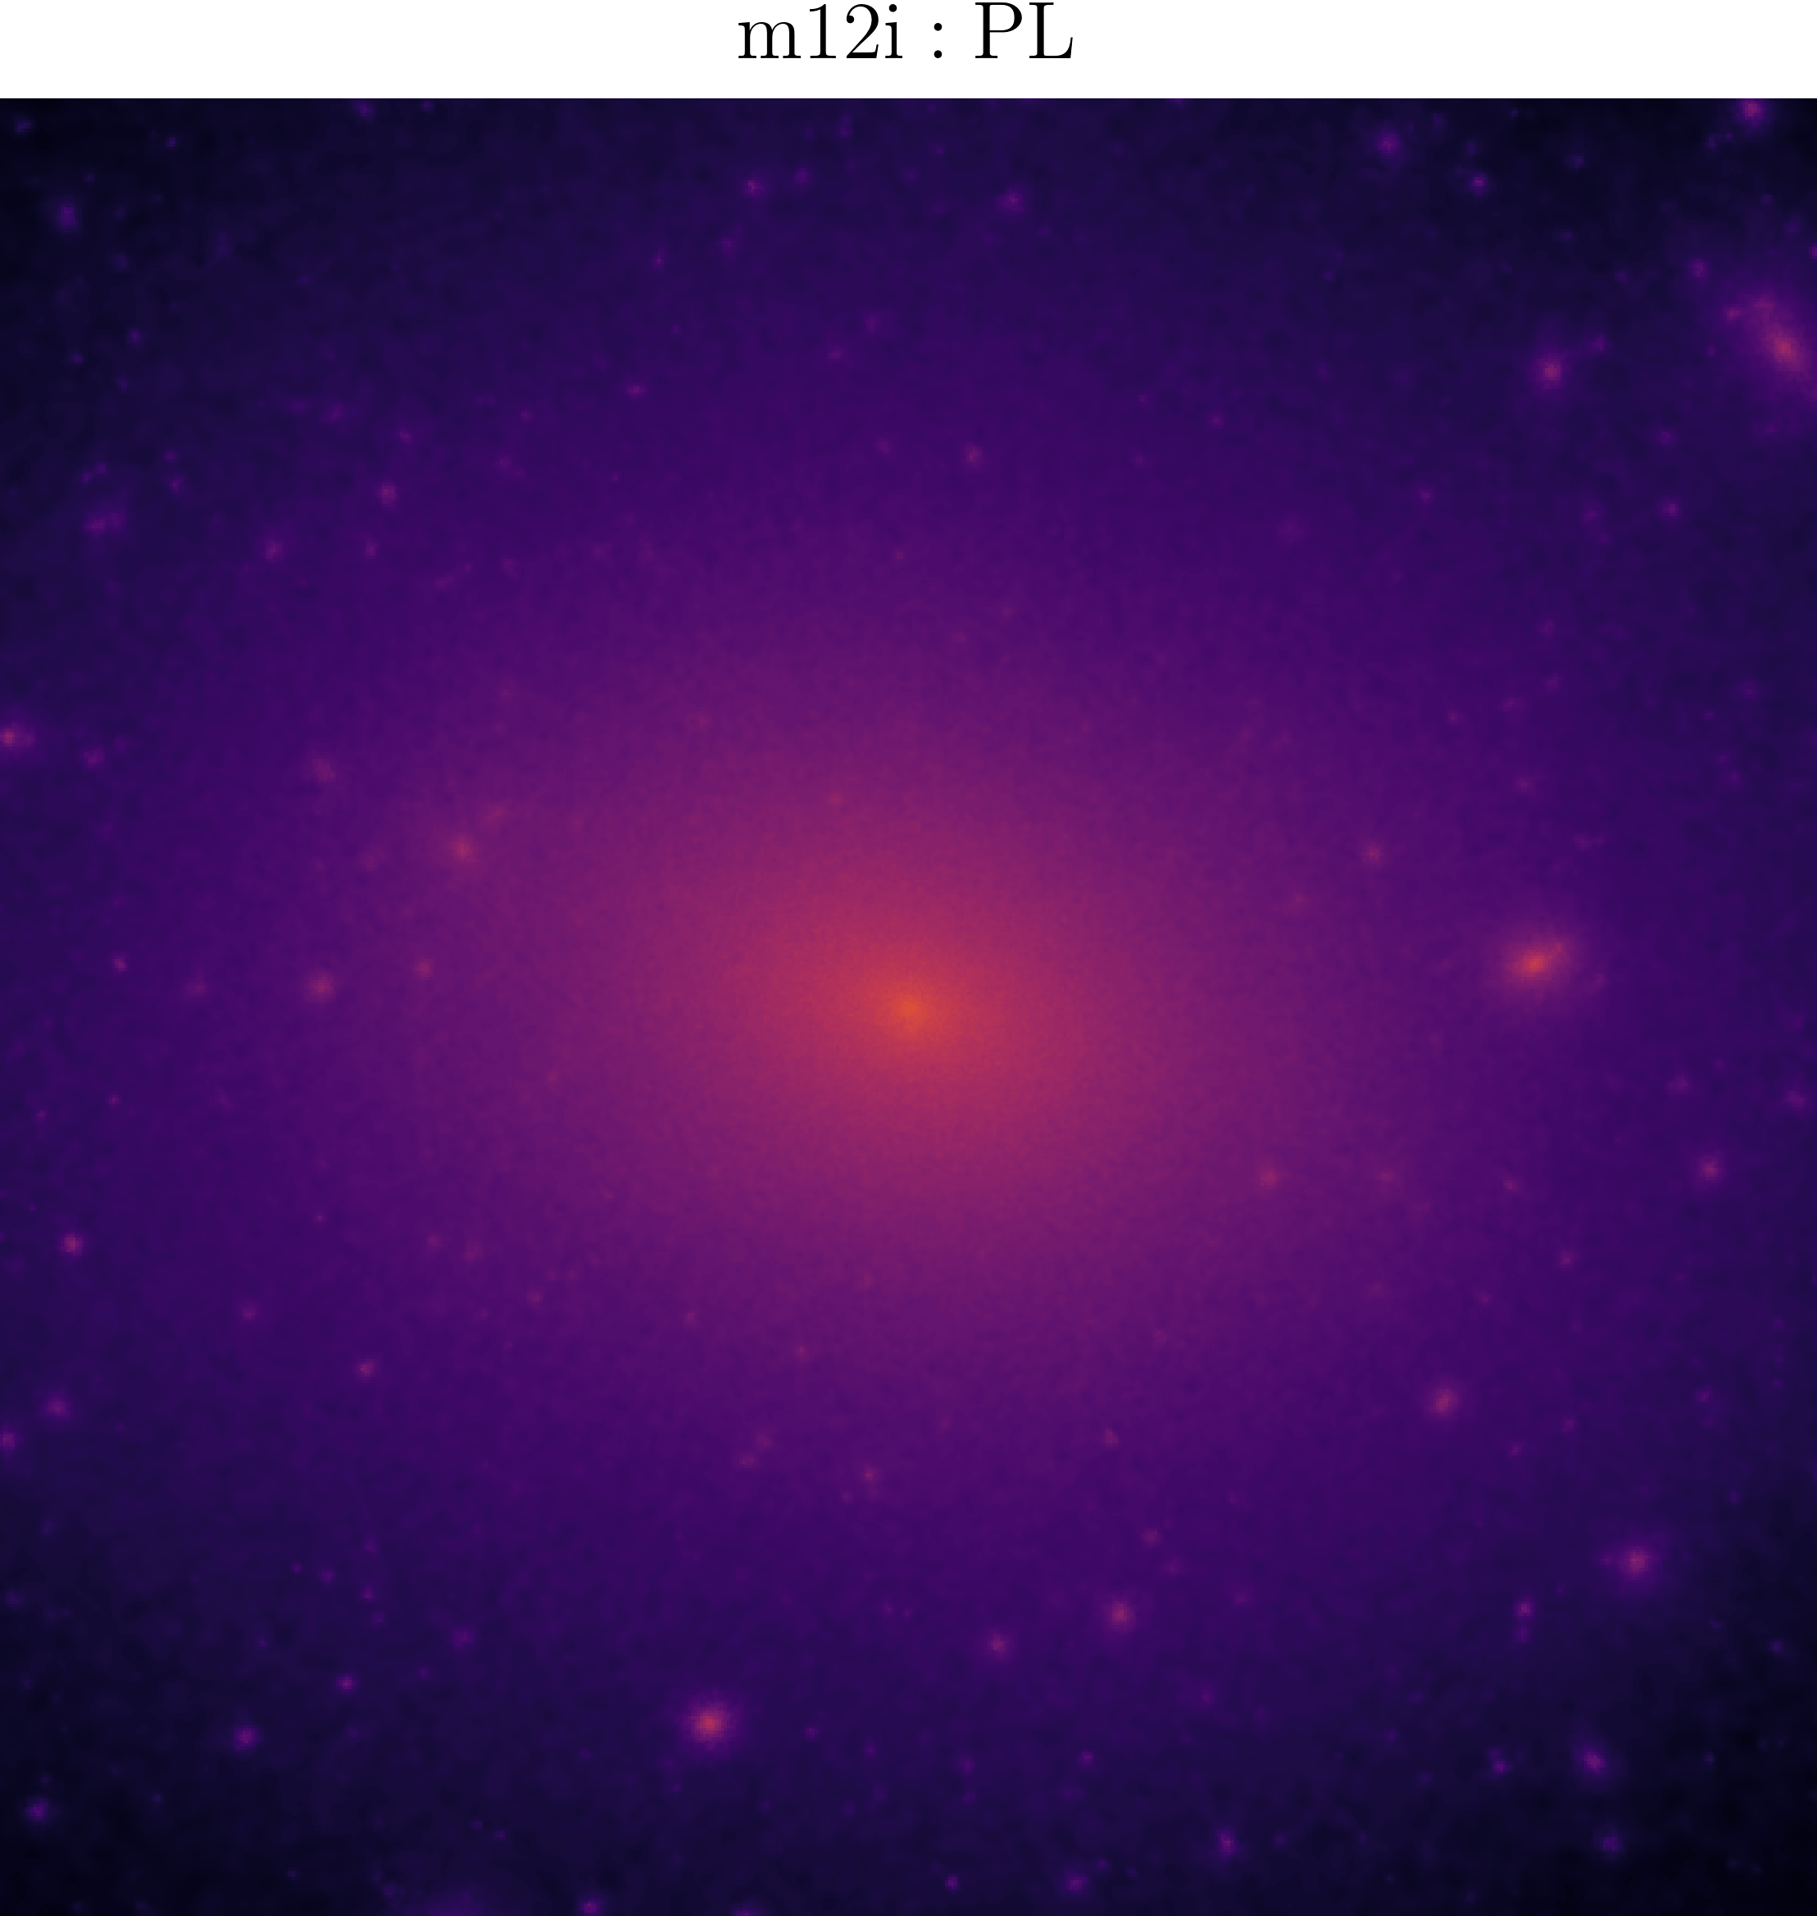
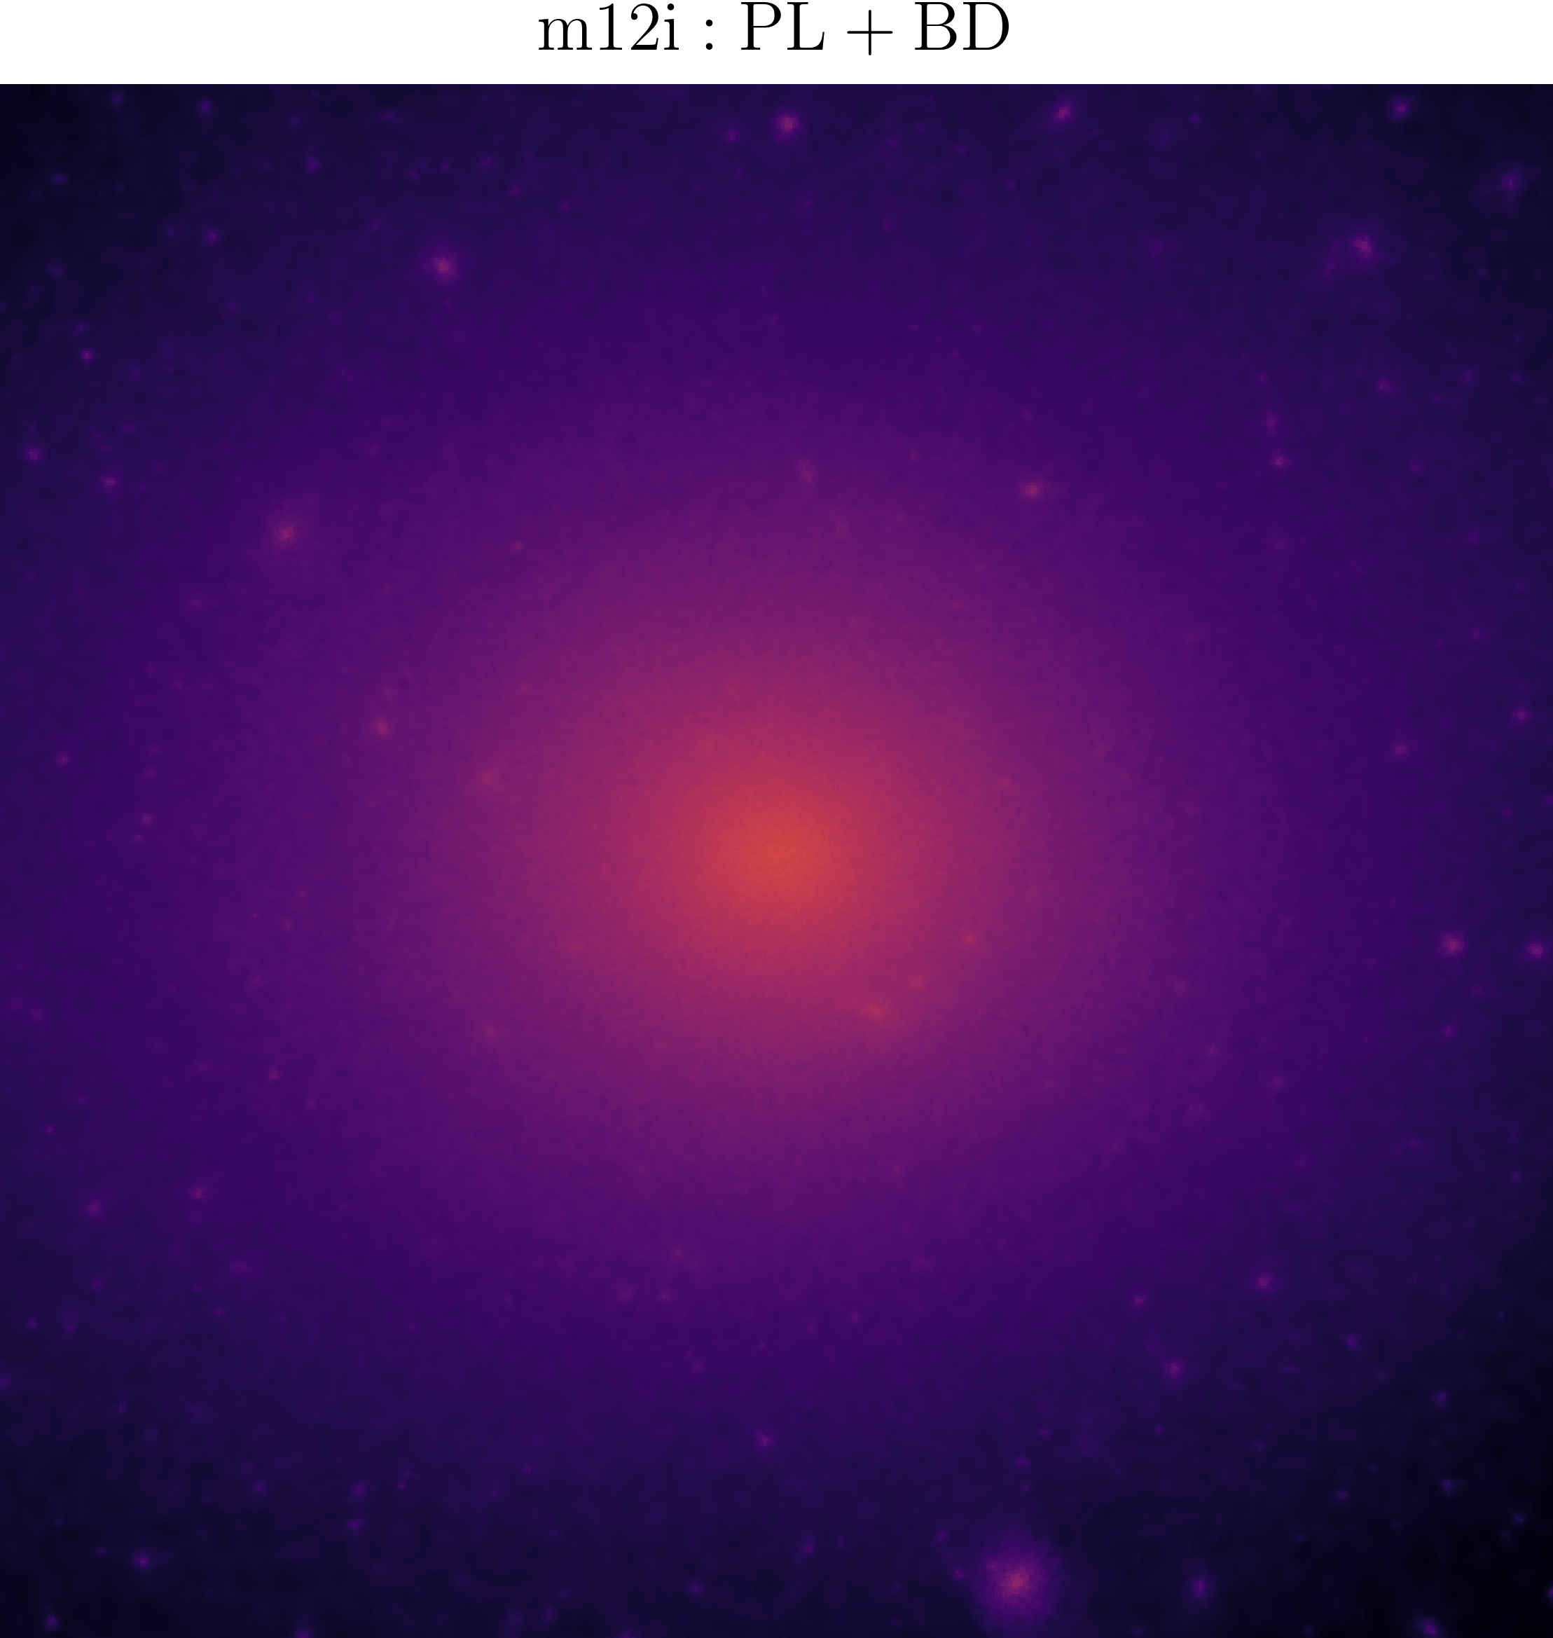
To help the Too-Many-Satellites (BD potential simulation)
[GK et al 2017] suggests the tidal disruption behaves the most severe within 50kpc of the main halo center! So below we show the 100 kpc cubic for m12i
[Wu, TKC In prep 1]

Slide 27
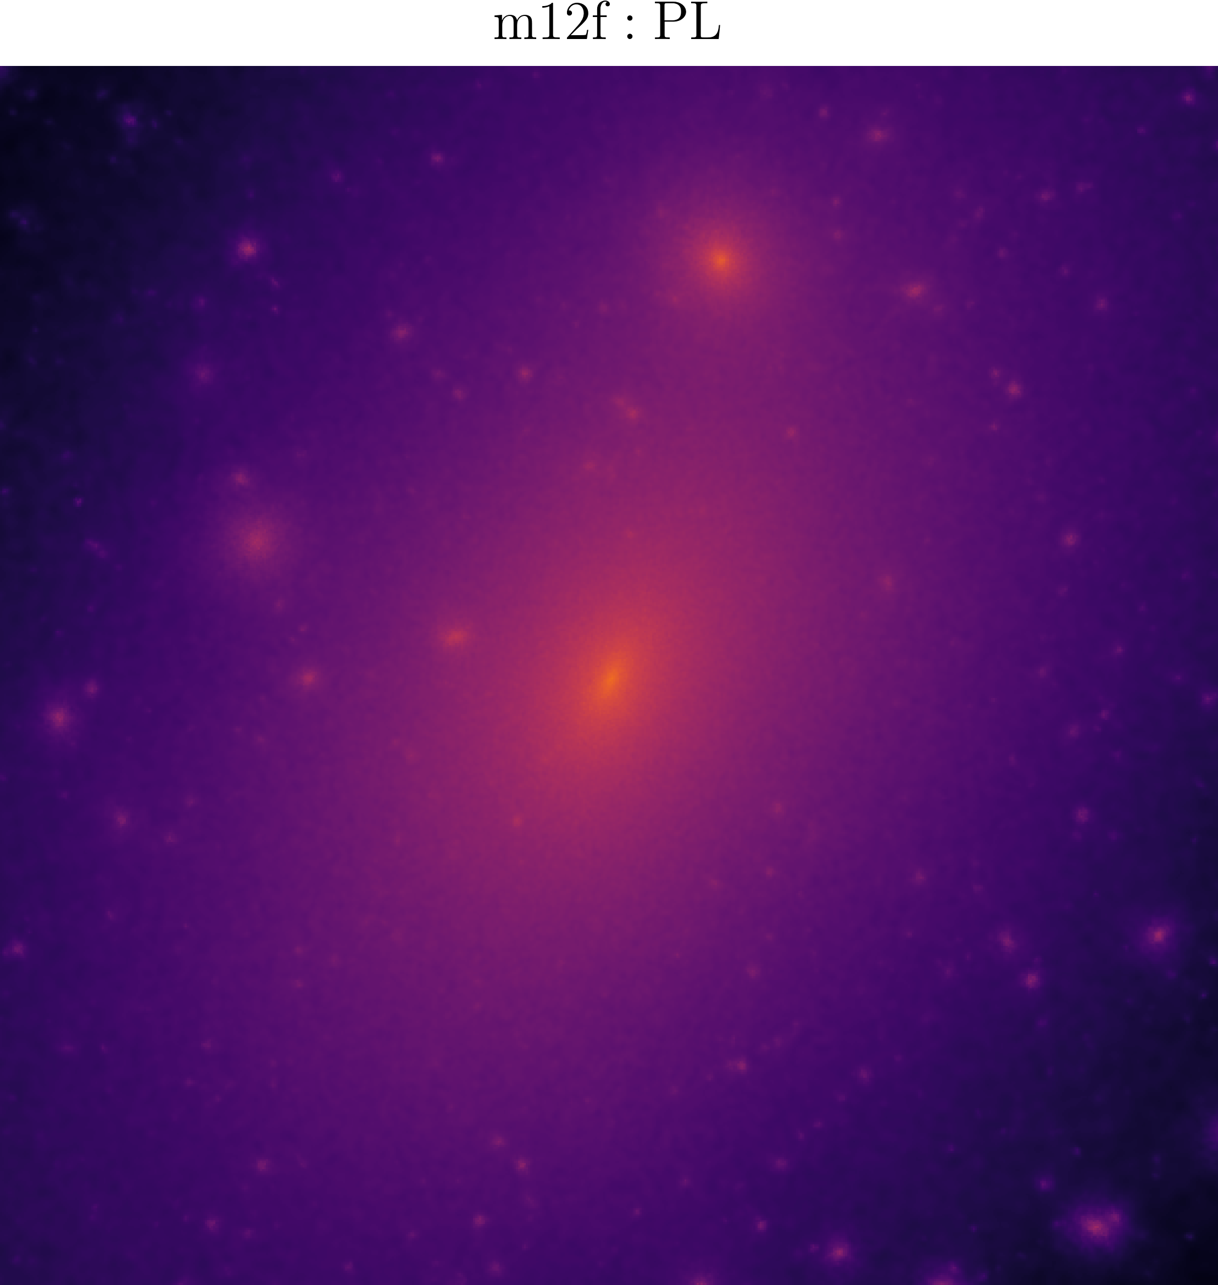
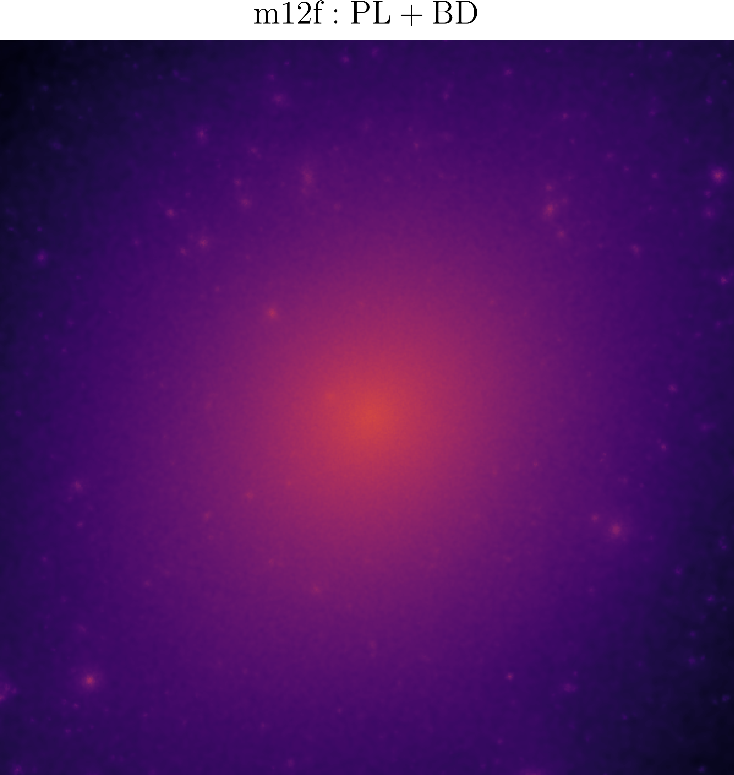
To help the Too-Many-Satellites (BD potential simulation)
For m12f
[Wu, TKC In prep 1]
For BT+BD runs, they are still running!

Slide 28
3. To explain the Strong Lensing Anomalies

Slide 29
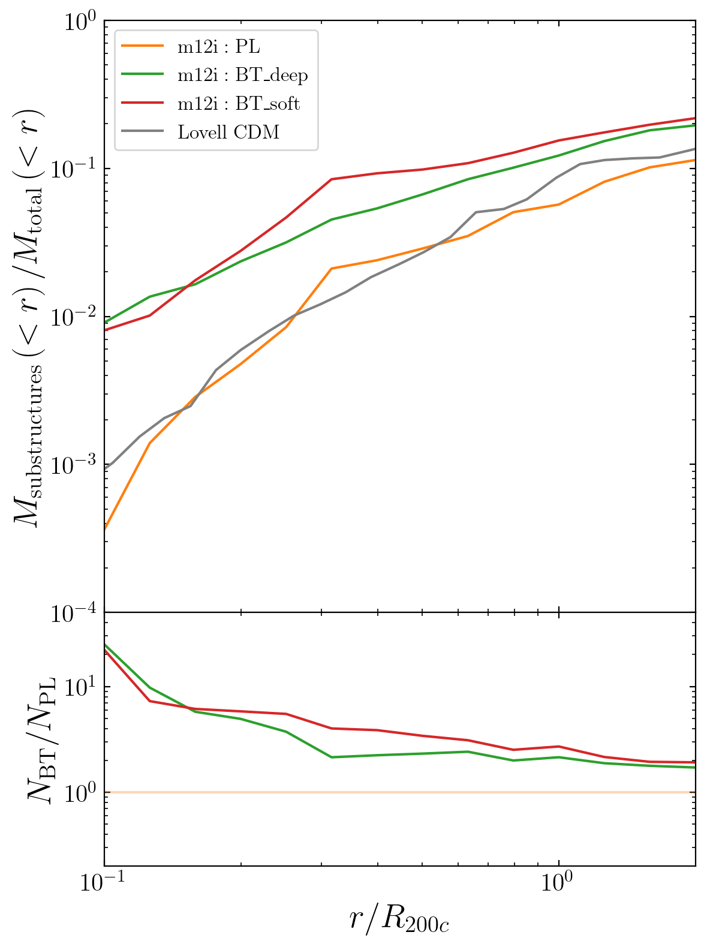
To help Strong Lensing (flux ratio anamolies)
scaled radial distance
substructure mass fraction:
Defined as mass of particles belonging to substructures(within radius r)/total mass(within radius r)
Blue-tilted model could reach an order of magnitude enhancement compared to traditional model
Substructure Mass Fraction
[Wu, TKC & Moreno arxiv 2024]
Ratio(BT over PL)

Slide 30
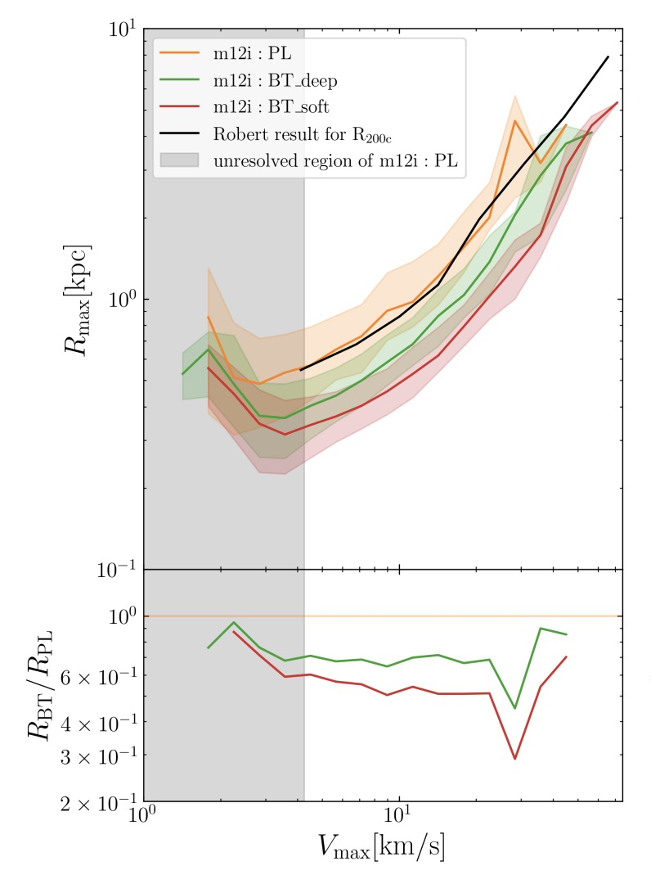
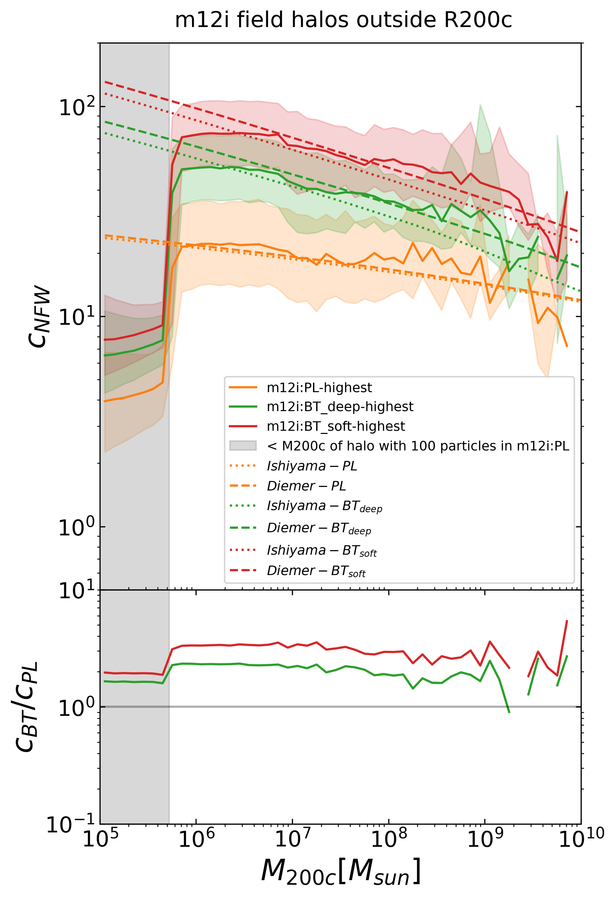
To help Strong Lensing (more concentrated subhalo)
Maximum circular velocity
M200c
[Wu, TKC In prep 2]
The Diemer19 and Ishiyama21 models for C-M-Z relationships are thus validated! At least for the soft and deep models!
The median Rmax/Cnfw within one Vmax bin
[Wu, TKC & Moreno arxiv 2024]
Ratio(BT over PL)

Slide 31
To help Strong Lensing (more concentrated subhalo)
After validating the Diemer19 and Ishiyama21 models, we used them to explore whether the allowable BT parameter space could reproduce the high concentration in [Simona 25 submitted]
And in both, the model (kp 17 ms 3.5) could reproduce c ~ 800!
[Wu, TKC In prep 2]

Slide 32
To help Strong Lensing (more concentrated subhalo)
Though the two analytical models are already validated for the BT_soft and BT_deep models, they are after all the extrapolation of standard cosmology c-m-z relations, we do not know whether they would still hold at such an extreme case (c~800 for 1e6.5 Msun subhalo)
We need another high-resolution Zoom-In simulation for a 1e6.5 Msun subhalo under BT(kp 17 ms 3.5)!

Slide 33
To help Strong Lensing (more concentrated subhalo)
Our simulation’s setting up:
1. Full box simulation for 1cMpc cubic cosmic volume, with particle mass ~ 277 Msun
2. Select a halo with ~1e6.5 Msun, trace back its particles to the initial condition, determine the zoom region, and re-simulate with HRS particle mass to be ~0.54 Msun
That would be high enough resolution for the halos to be resolved!

Slide 34
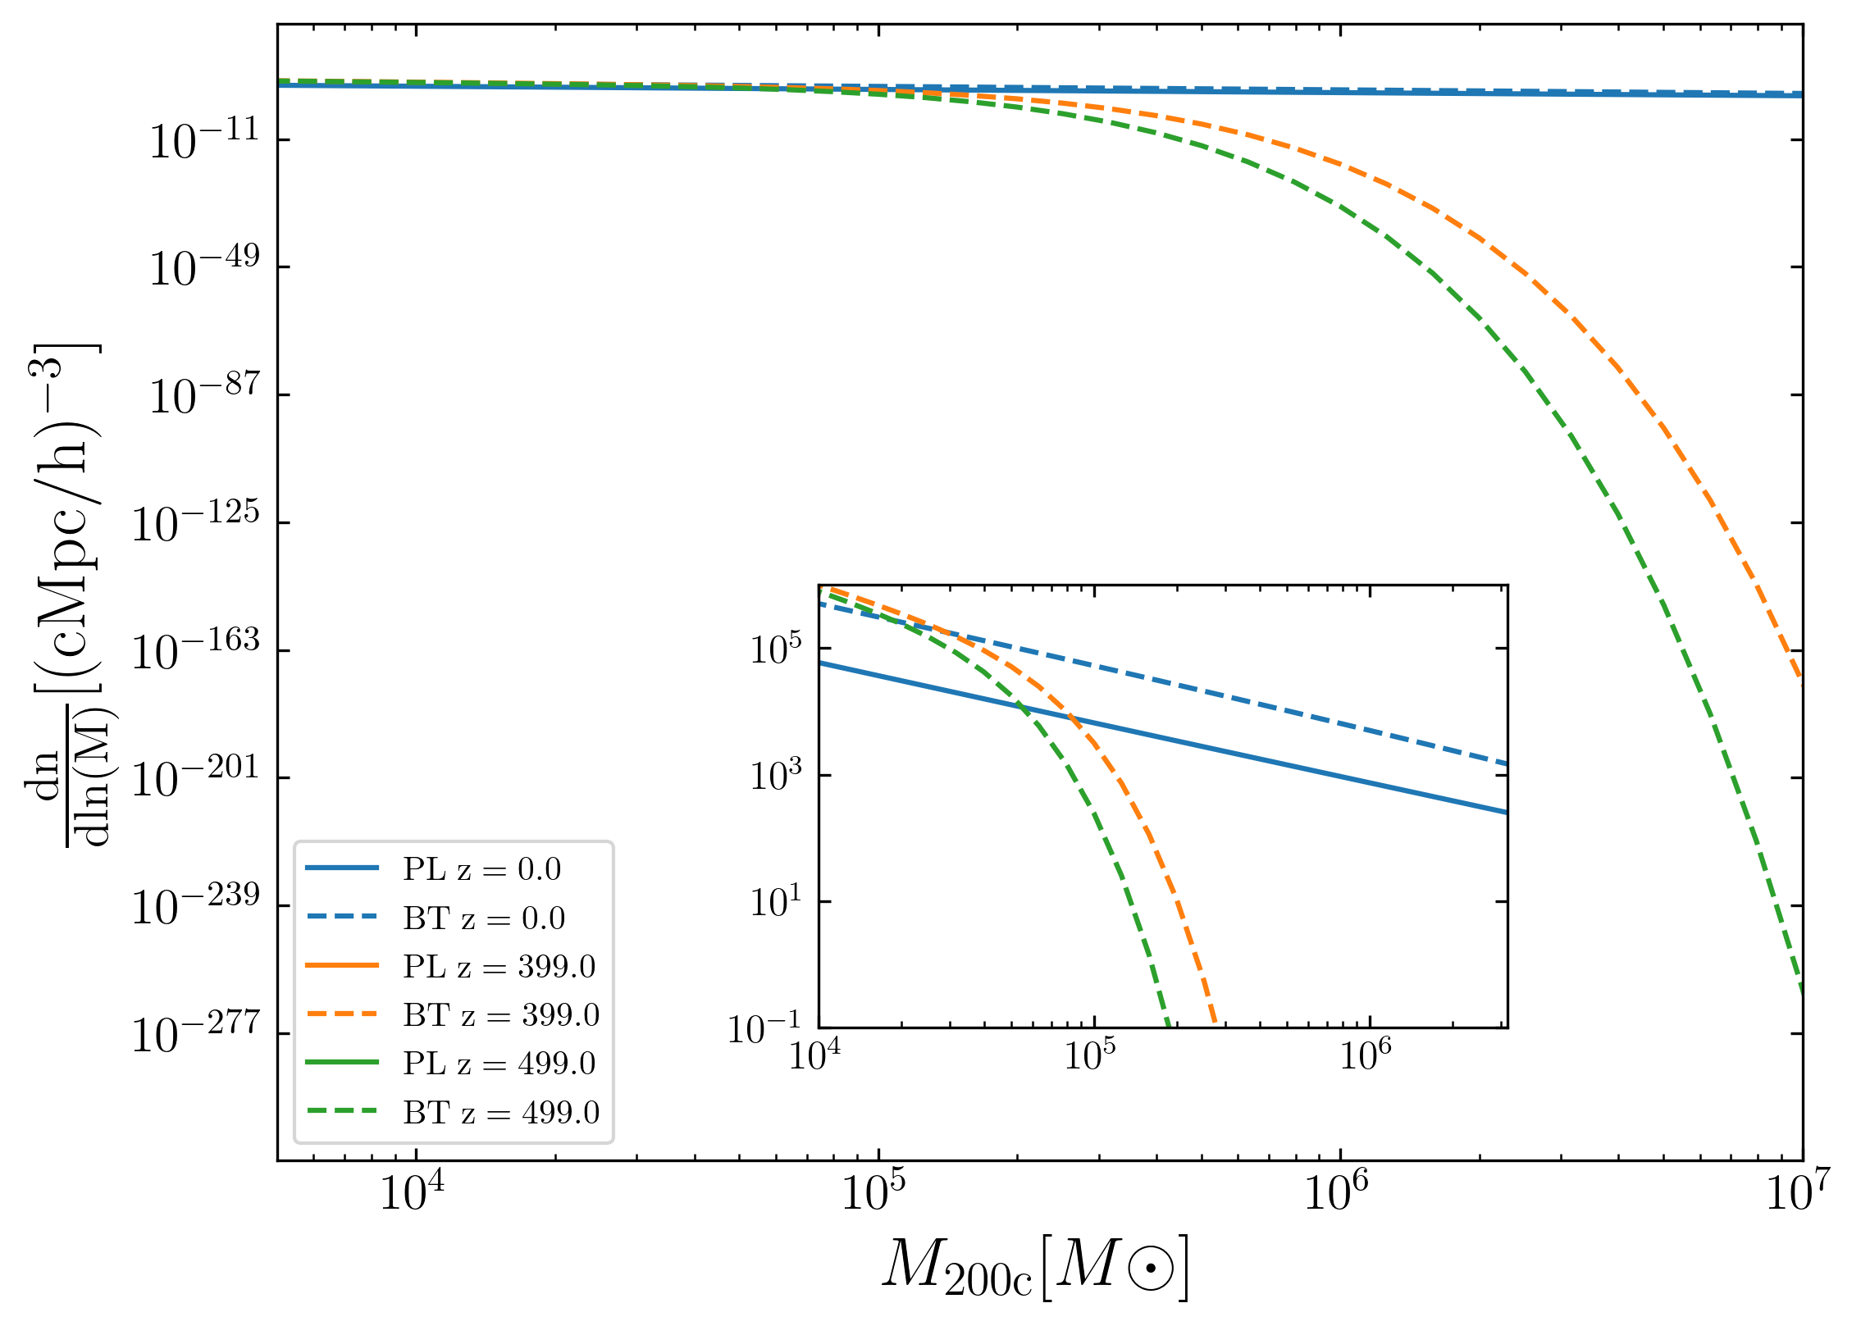
To help Strong Lensing (more concentrated subhalo)
The high concentration in BT comes from the earlier formation when the critical density of the universe is also higher
So we need to ensure the simulation starting redshift is high enough!
The central density in [Simona 25 submitted], is comparable to critical density at ~400
[Wu, TKC In prep 2]
Another question: while the critical density at ~ 400 is high enough, could structures indeed form? Yes!!!
Simulations are now still running!
To be safer, we set z_start = 499

Slide 35
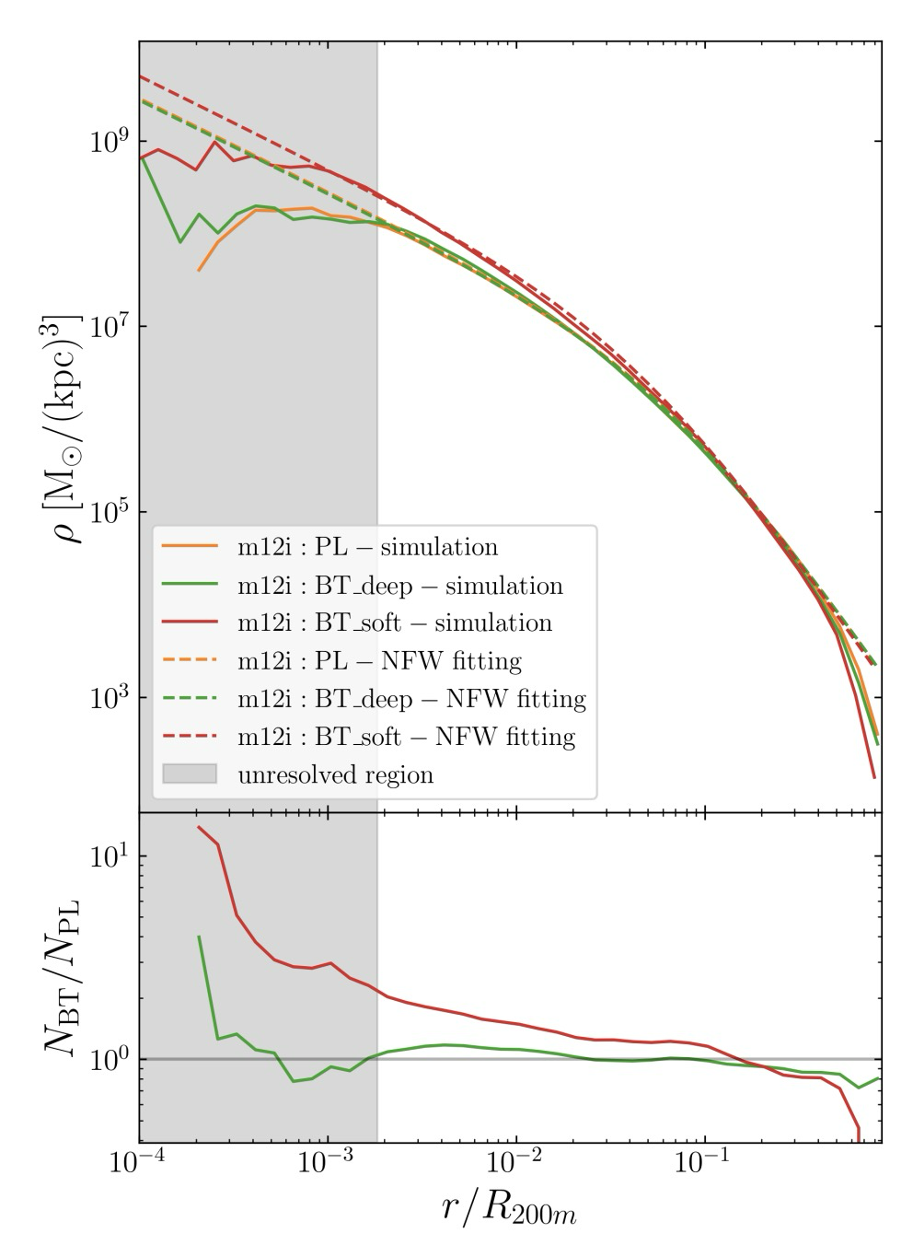
By-Product: Main halo (could) be more concentrated
scaled radial distance
[Wu, TKC & Moreno arxiv 2024]
But only in BT_soft, BT_deep is very close to standard model!
And That fits well with our prediction!
radial density
Ratio(BT over PL)

Slide 36
Summary
1. Background and Motivations:
- what is the standard cosmology model(PL+LCDM)
- which part we want to modify(PL->BT) and what motivates us to do so (JWST)
- what problems we want to solve with the new model
2. To solve the too-many-satellites problem
- DMO simulation [Wu, TKC & Moreno 2024]+DMO-BD potential simulation [Wu & TKC, in prep 1]
3. To explain the strong lensing anomalies
- Over-concentration events [Wu, TKC & Moreno 2024]+[Wu & TKC, in prep 2 ]
- Flux Ratio Anomalies [Wu, TKC & Moreno 2024]+some future works?

